Slide 1

New Program New Site
Use this process to add a new program to a
location that has not yet been approved
*Use the Existing Program tab to add a previously approved program to a new location

Slide 2
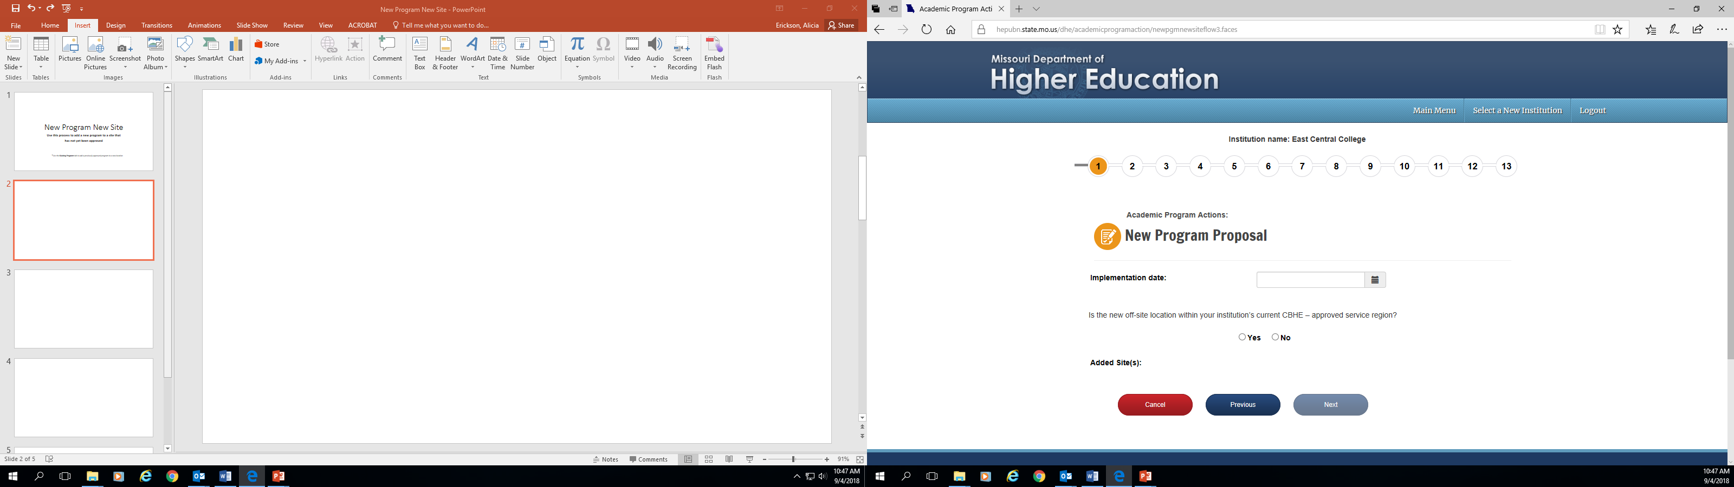
You should see your institution’s name at the top of the screen. If you manage academic program approvals for multiple institutions, confirm that you are submitting for the correct institution.
The numbers 1-13 indicate how many pages are included in the submission process.
This is the date the program will begin to be offered. The date format is MM/DD/YYYY.
If no is chosen, you will be directed to contact MDHE regarding the comprehensive review process for the new program.
New Program New Site

Slide 3
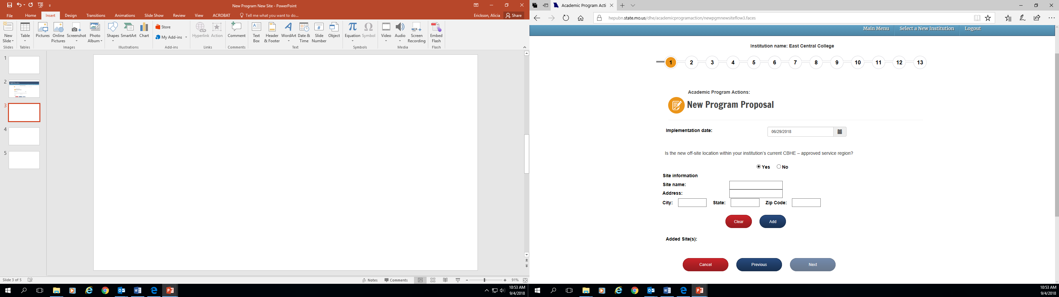
If the new site is within your institution’s current CBHE-approved service region, you will be prompted to enter the name and address of the site.
Once the information is entered, click Add before advancing to the next screen.
New Program New Site

Slide 4
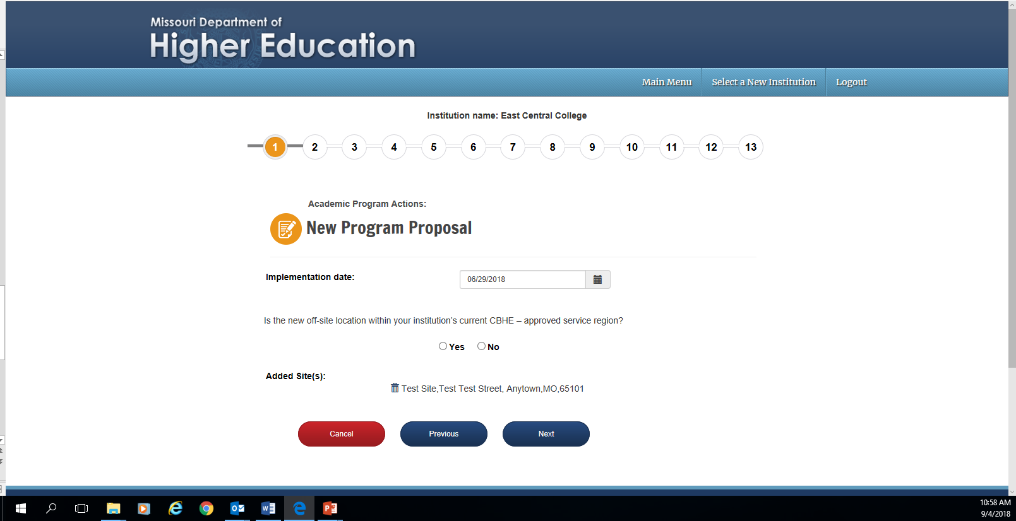
If you are adding the program to more than one new site, begin the process again of choosing whether the site is within your institution’s current CBHE-approved service region.
New Program New Site

Slide 5
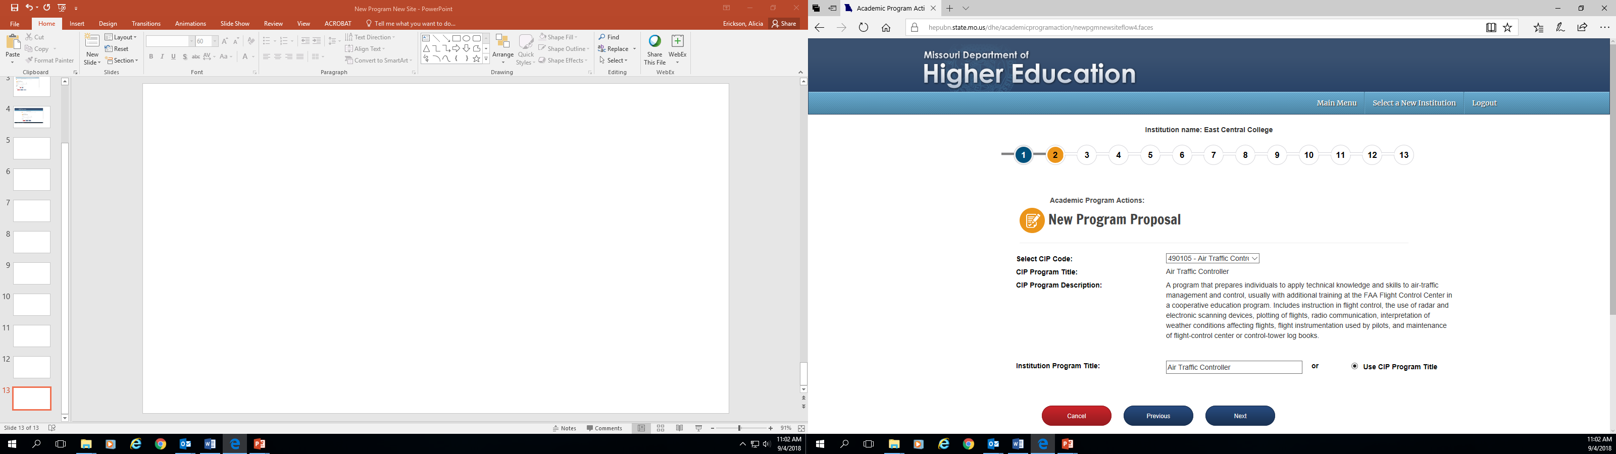
Select the program’s CIP code. CIP codes are in alphabetical order. CIP code titles can be looked up: https://nces.ed.gov/ipeds/cipcode/Default.aspx?y=55.
The CIP code title and program description from IPEDS will appear here.
Enter the program title here, or choose the radio button to use the CIP program title.
New Program New Site

Slide 6
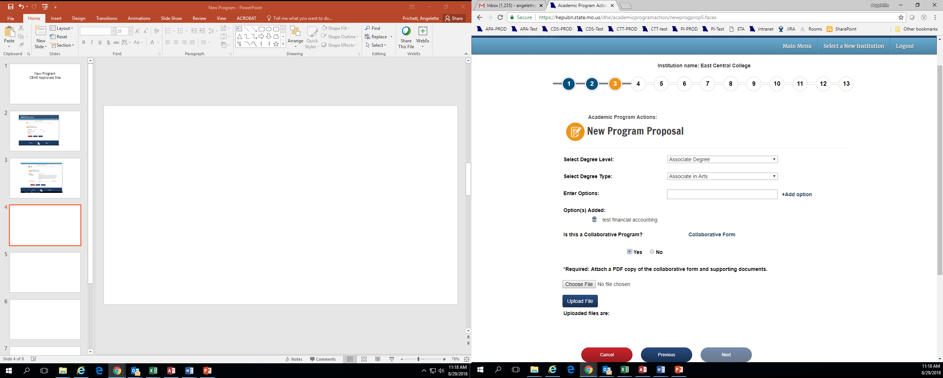
Choose the program’s degree level (Associate Degree, Bachelor’s Degree, etc.).
Choose the degree type. If you do not see your program’s degree type on the list, please contact MDHE so they can add it.
If the new program has options, enter the title here and click Add Option.
If the new program is being offered in collaboration with another institution of higher education, choose Yes. If not, choose No.
If Yes, download, complete and save the Collaborative Form on your computer.
Upload the completed file. Only PDFs can be attached (no Word docs).
New Program New Site

Slide 7
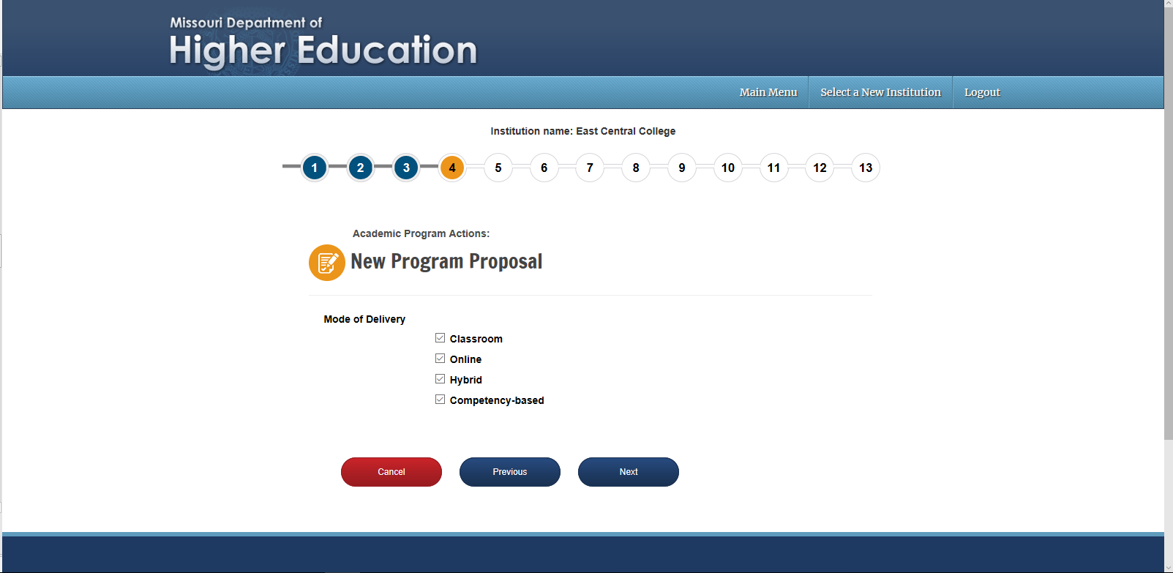
Indicate how your program will be delivered. Note that Online programs will no longer appear as a separate entry in the MDHE program inventory.
New Program New Site

Slide 8
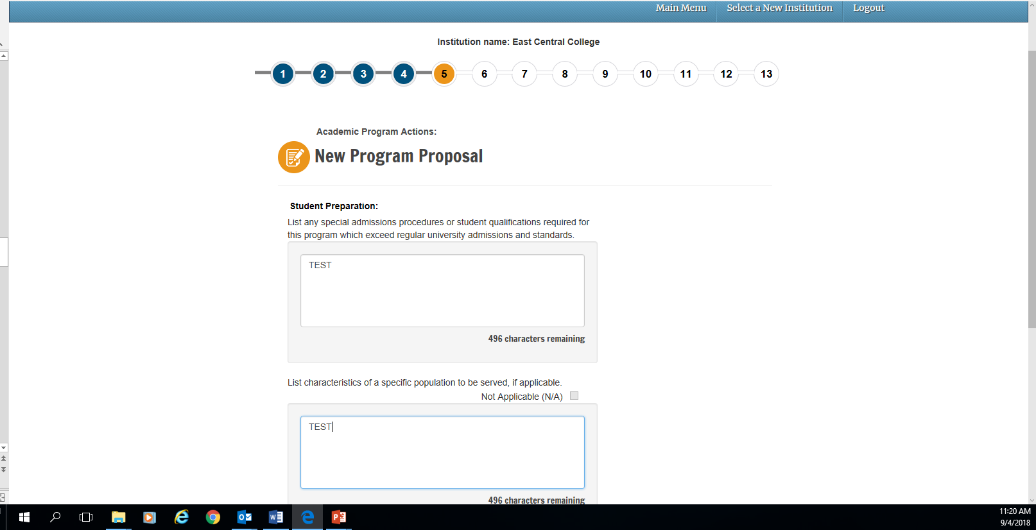
Provide a response, or type “none” if there are no special admissions requirements. Note that there is a feature to upload additional documents at the end of this process should you need more room to answer the question.
Provide a response, or check the N/A box if there are no specific populations served by the new degree program. Note that there is a feature to upload additional documents at the end of this process should you need more room to answer the question.
New Program New Site

Slide 9
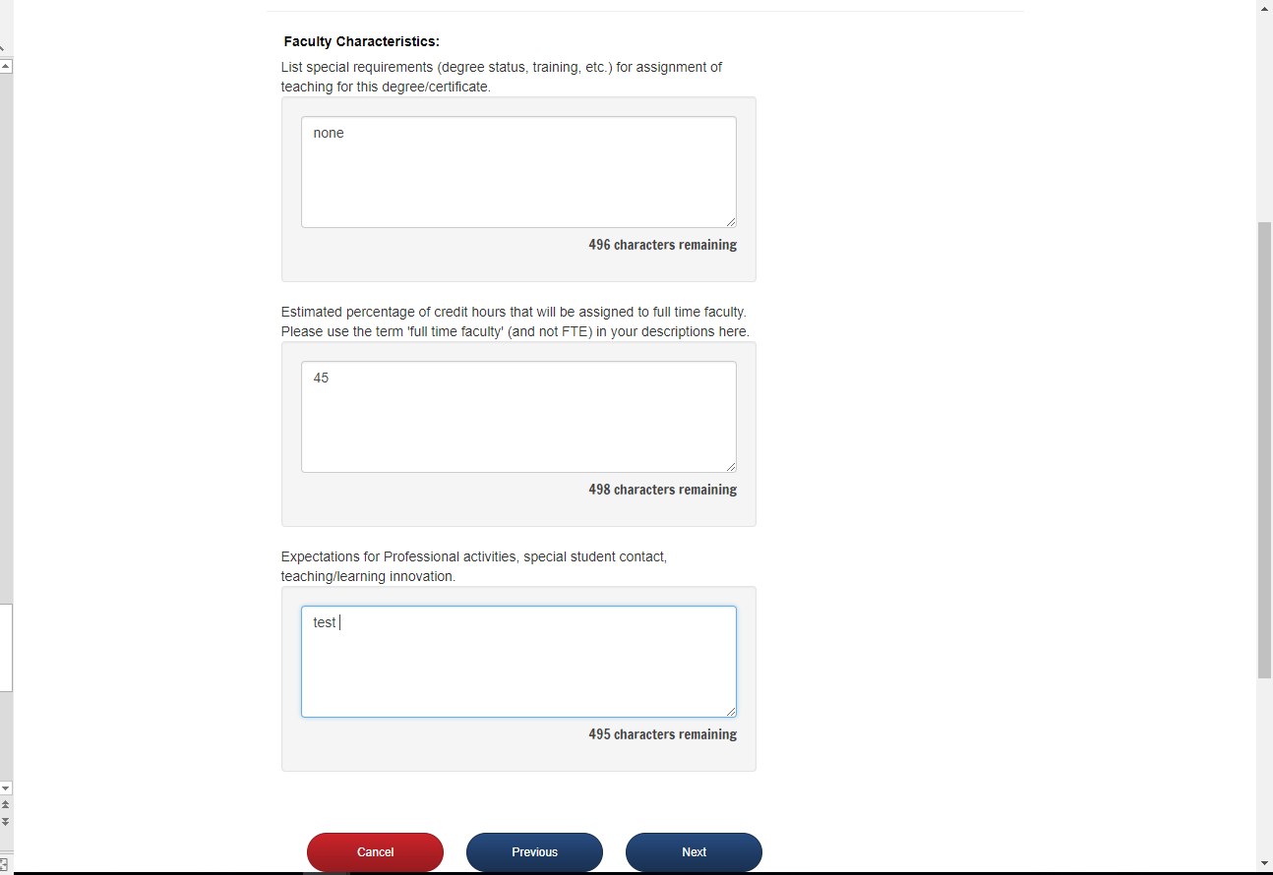
Please provide a response, or type “none” if there are no special faculty requirements. Note that there is a feature to upload additional documents at the end of this process should you need more room to answer the question.
Please provide a percent, and any supporting information. Note that there is a feature to upload additional documents at the end of this process should you need more room to answer the question.
Please provide a response, or type “none” if there are no expectation. Note that there is a feature to upload additional documents at the end of this process should you need more room to answer the question.
New Program New Site

Slide 10
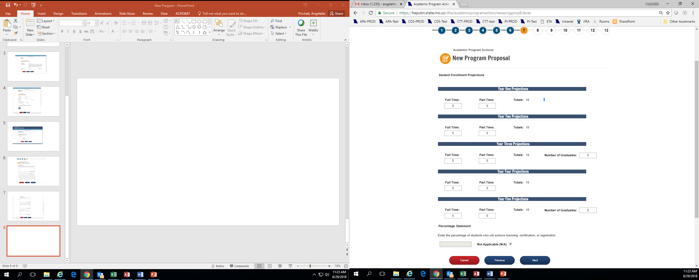
Enter the projected number of students enrolled in years 1 – 5.
Enter the number of projected graduates in years 3 and 5.
Enter the percentage of students who are projected to achieve licensing, certification, or registration, if applicable.
New Program New Site

Slide 11
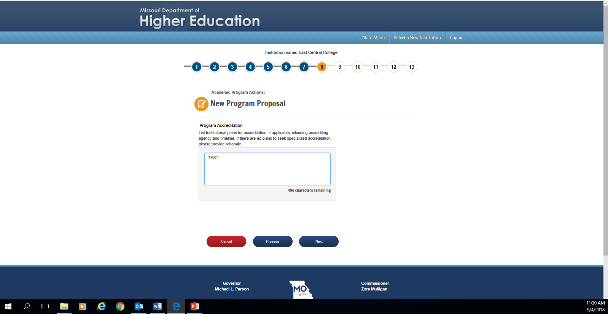
Provide the plans for accreditation, or if no plans provide rationale. Note that there is a feature to upload additional documents at the end of this process should you need more room to answer the question.
New Program New Site

Slide 12
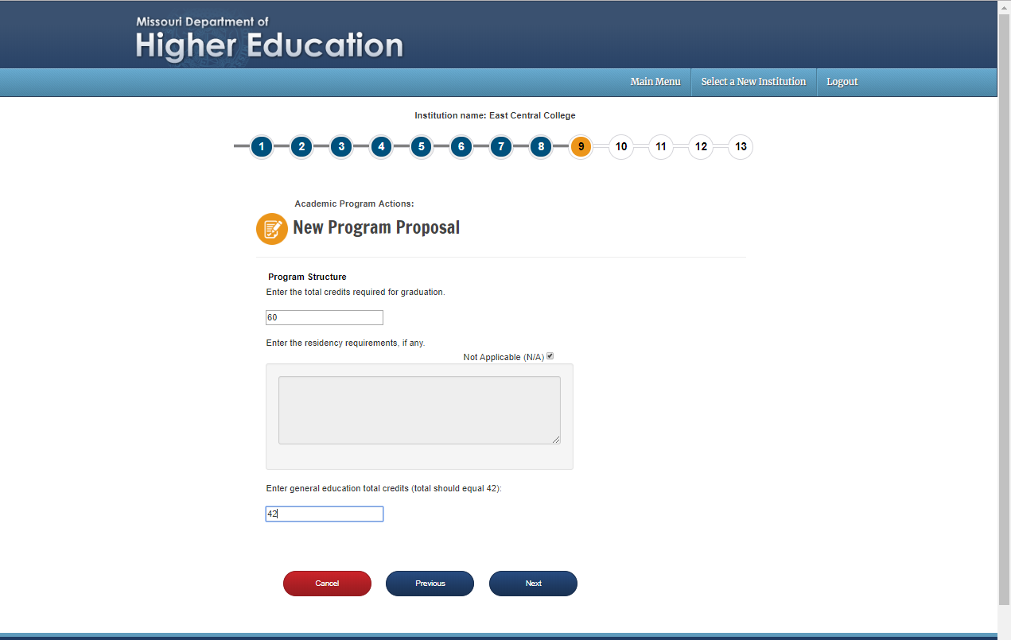
Enter the total number of credits in the program here.
Enter the residency requirements, or check N/A.
Enter the general education total credits. While the suggestion is 42, other totals can be entered here without disrupting the process.
New Program New Site

Slide 13
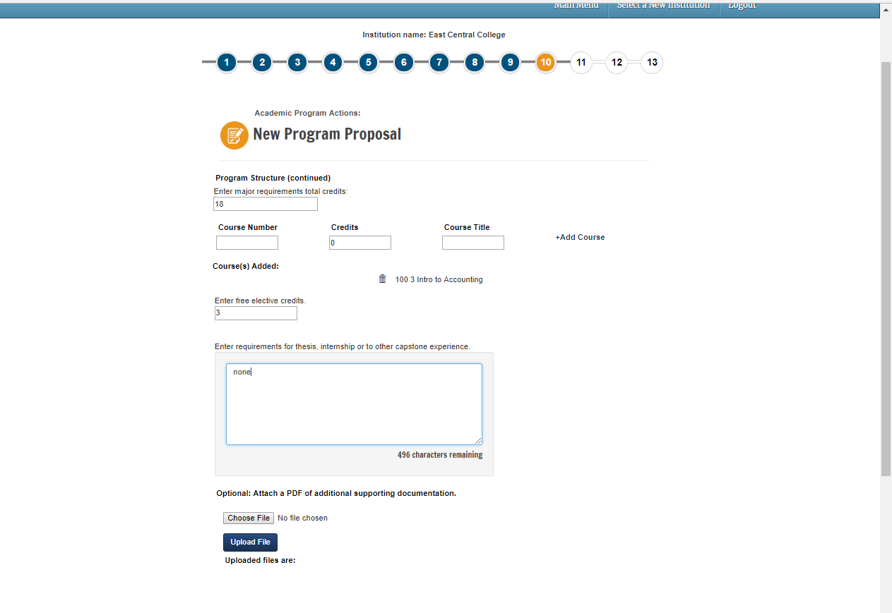
Enter the total number of major requirement credits in the program here.
Enter each course in the major. When you are done entering a course, hit Add Course. Your fields will clear and then you can add the next course. Note that you will also have to upload a pdf of the curriculum at the end of this process.
Enter the number of elective credits.
If there is a thesis, internship, or capstone requirement, describe it here.
Any additional supporting information about the program structure can be attached here.
New Program New Site

Slide 14
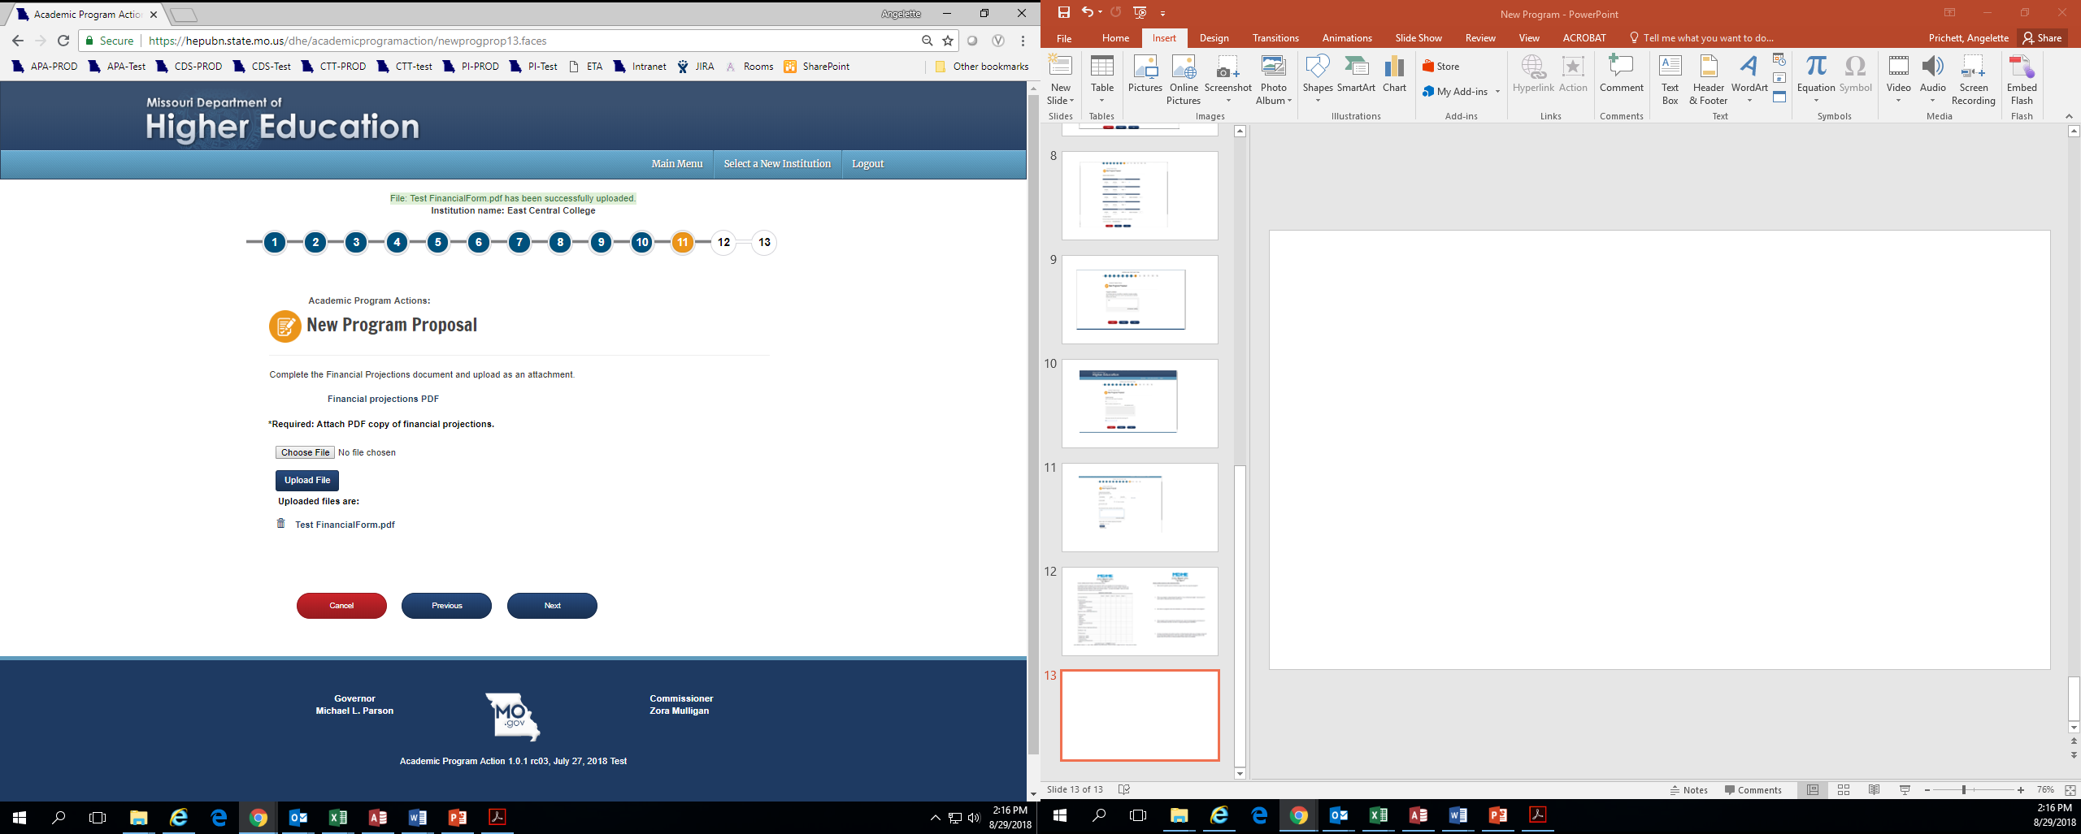
Click to open the Financial Projections PDF. Save it on your computer, complete it, and then re-upload the document (public institutions only).
New Program New Site

Slide 15
Financial Projections Form
This form must be completed by public institutions proposing a new program. Independent institutions will not see the prompt to download this form.

Slide 16
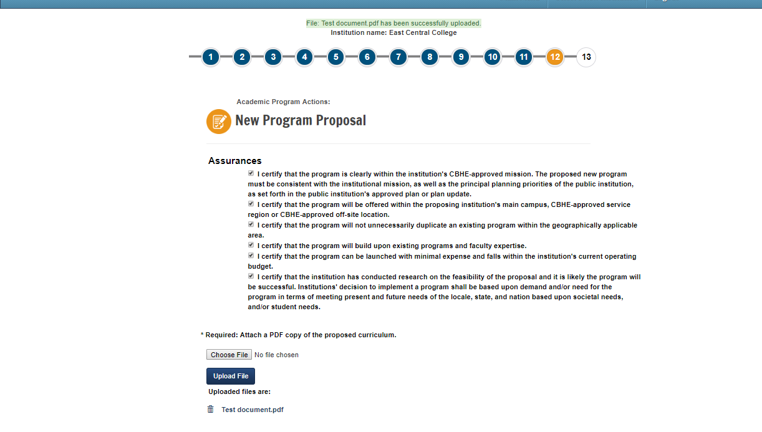
Read and check the assurances. Assurances for public institutions will be different from independent institutions.
Upload a PDF of the proposed new curriculum.
New Program New Site

Slide 17
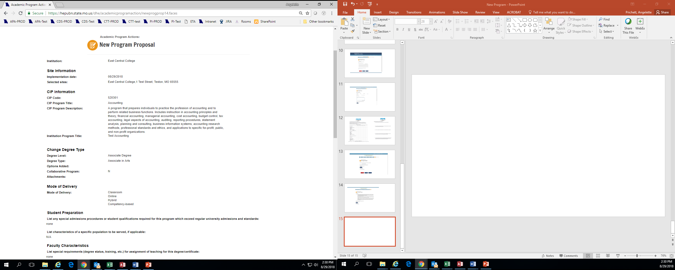
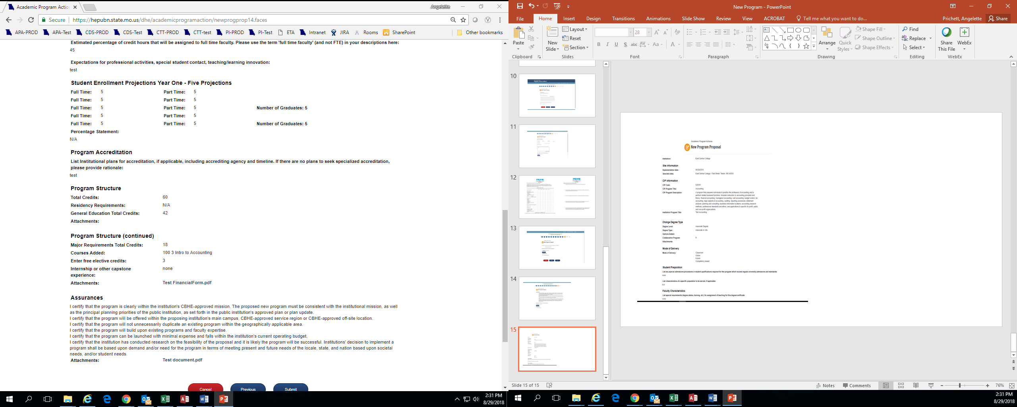
Prior to submission, you will see a screen summarizing your program. If correct, choose submit. If you hit cancel, all of the information entered will be lost.
New Program New Site

Slide 18
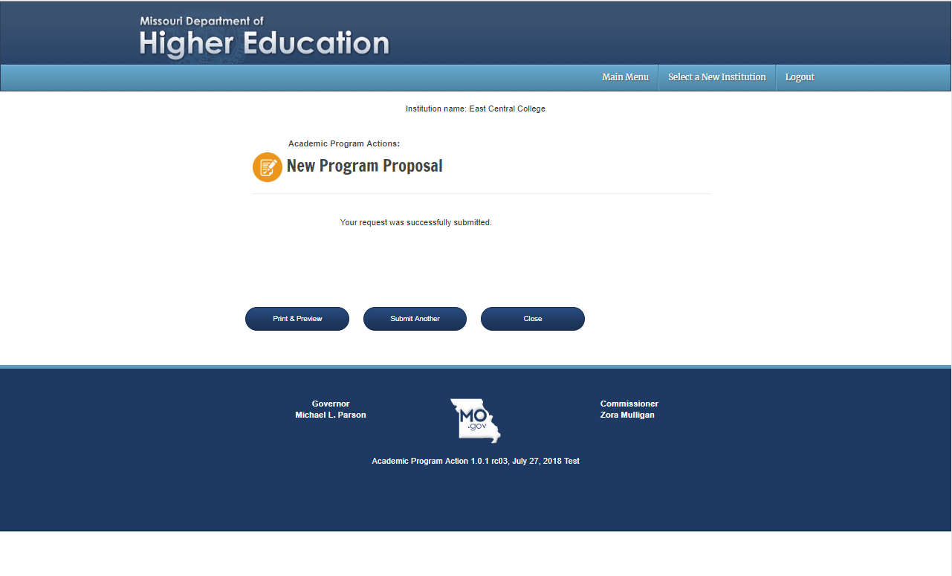
After submission, you can choose Print & Preview to save a copy for your files.
If you have additional new programs to submit, choose submit another.
Close takes you back to the main menu.
New Program New Site

Slide 19
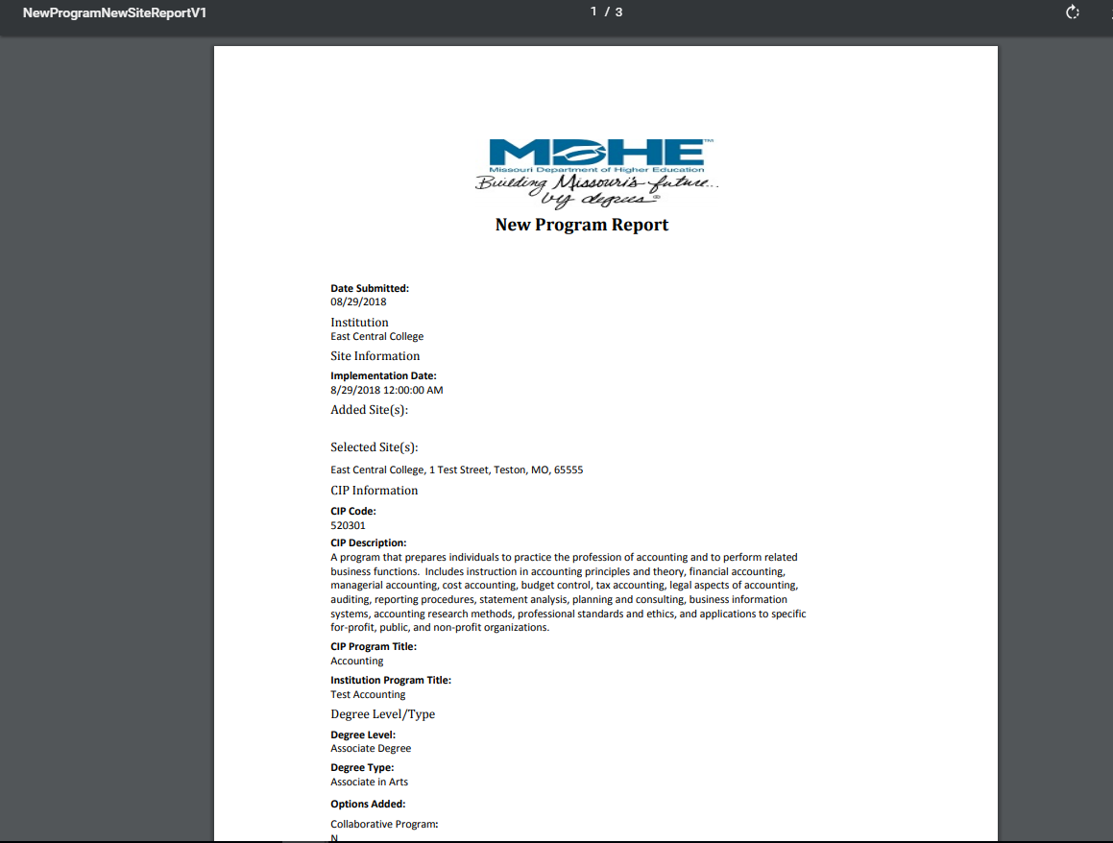
Once you have submitted a new program, it will enter a queue for staff review. It will be posted for review on the MDHE website on the first business day of the next month. Upon approval, your program will be uploaded to the MDHE inventory.
Upon approval, your program will be assigned a unique identifier to help track changes and for data reporting purposes.
New Program New Site

