Slide 1
Technical Solutions: CORE 42
Cheryl Dobson, Registrar – MSSU
Gavin O’Connor, Special Asst to the Provost – OTC
Mel Stegeman, Registrar – STLCC

Slide 2
Presentation Overview
Policy Overview/References
Institutional Website & Publications
Landing Pages
Class Schedule (Public & Student)
Catalog Info (MOTR logo and #)
Publications (Emails to students, faculty, staff)
Transfer Guides & Articulation
Equivalencies
Non-Equivalent MOTR Courses
Transcript & CORE 42 Stamp
Unofficial & Official Transcripts
Stamp Logic

Slide 3
Overview of Policy and References
SB 997 passed, included provision to establish:
42-hour core transfer block for all public higher ed institutions, created and approved by state-wide committee
Common course numbering matrix to provide key for courses at the lower division transfer equivalencies
Appeals process for dissatisfied students
Requires MDHE to evaluate transfer practices across the State
Policy: https://dhe.mo.gov/about/legislative/legislativeinitiatives.php
MDHE working document: https://dhe.mo.gov/documents/CORE42COMPILATIONEQUIVALENCIES.updatedJan32018.pdf

Slide 4
Institutional Websites & Publications
Landing Pages, Class Schedules, Catalogs, Publications

Slide 5
MSSU: Website Reference https://www.mssu.edu/student-affairs/registrar/42-hour-block.php

Slide 6
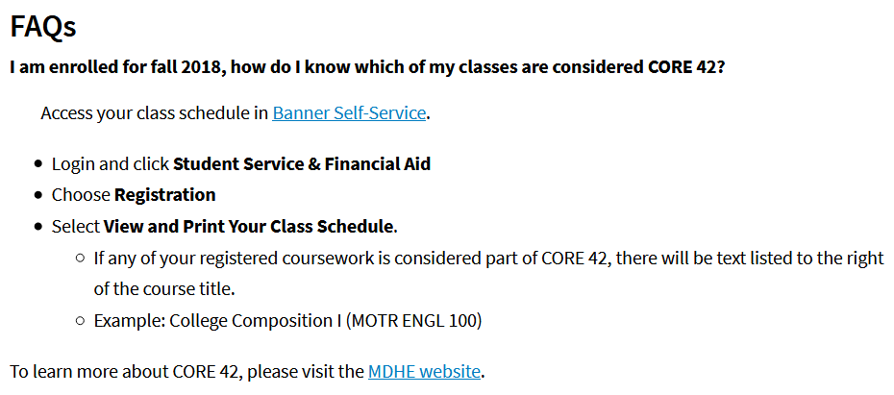
STLCC: Website
https://www.stlcc.edu/admissions/office-of-the-registrar/core-42.aspx

Slide 7
STLCC: Student Schedule Search
Using Banner!? Create course attributes in STVATTR; attach attributes to courses in SCADETL.
STLCC categorized the courses by Knowledge Area.

Slide 8
STLCC: Student Schedule Search

Slide 9
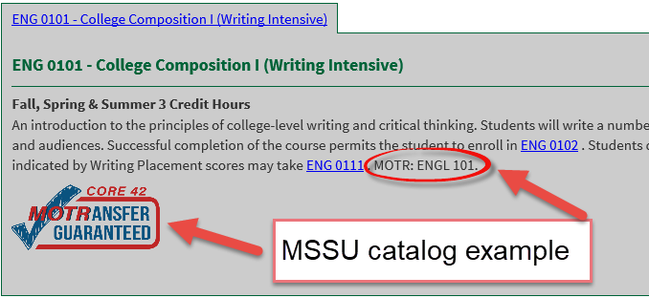
MSSU: Catalog
Admissions Information: Transfer students who have completed the State of Missouri general education curriculum (42 semester hour – Gen Ed Block) or have earned the Associate of Arts (AA) degree from a two-year or four-year regionally accredited institution or foreign equivalent of an AA have met the MSSU general education curriculum requirements.
Course Description: (Eventually shows on the College Source Transfer Guide)

Slide 10
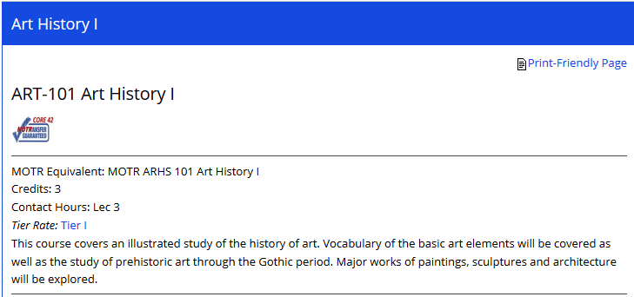
OTC: Catalog

Slide 11
STLCC: Catalog
If you are a Banner school, you can update the course title to include more than 30 characters in SCASYLB.

Slide 12
STLCC: Catalog
STLCC utilizes the Long Course Title option in SCASYLB; this allows the catalog to display the corresponding MOTR course. By including the MOTR course, STLCC will have a permanent and accessible archive of which courses were part of MOTR.

Slide 13
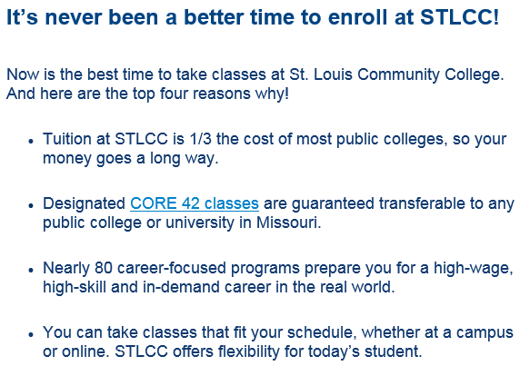
STLCC: Emails to Students

Slide 14
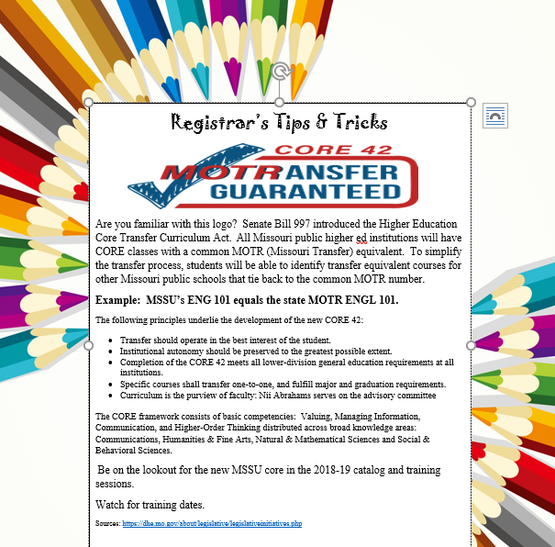

Slide 15
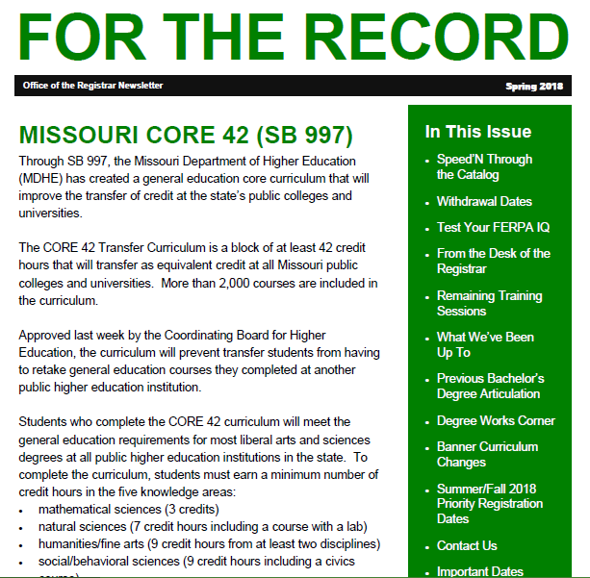

Slide 16
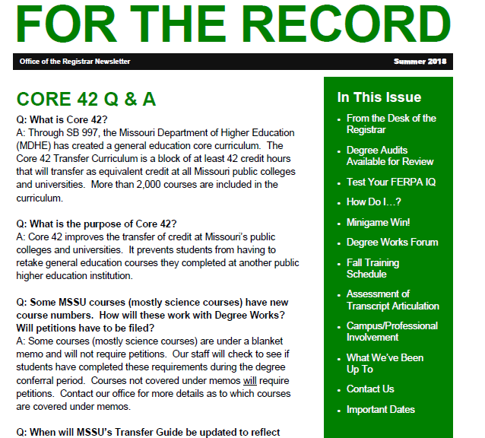

Slide 17
Transfer Guides & Articulation
Guides, Articulation, Equivalencies v. Non-Equivalencies

Slide 18
Transferring Courses – State Guidance
CORE 42 Guarantees transfer of the block, all MOTR courses
Other courses may be part of campus Gen Ed, but if they are not a MOTR course and the Gen Ed is not completed, they may or may not transfer
MDHE sent master spreadsheet for institutions to review
Check for errors
Ensure you have equivalents
Will be iterative process
MOTR courses fulfill requirements and pre-reqs for subsequent courses
Some MOTR courses may not match a course you offer
Need to establish an equivalent place holder
Must honor the MOTR credit
If number of credits unequal, “extra” is to be applied toward 42 cr. hr. minimum
Must fulfill “category” such as humanities or communication
CORE 42 must be on transcript, MOTR in catalog and logo

Slide 19
MSSU used the CORE spreadsheet to align courses for articulation, Transfer Guide,

Slide 20
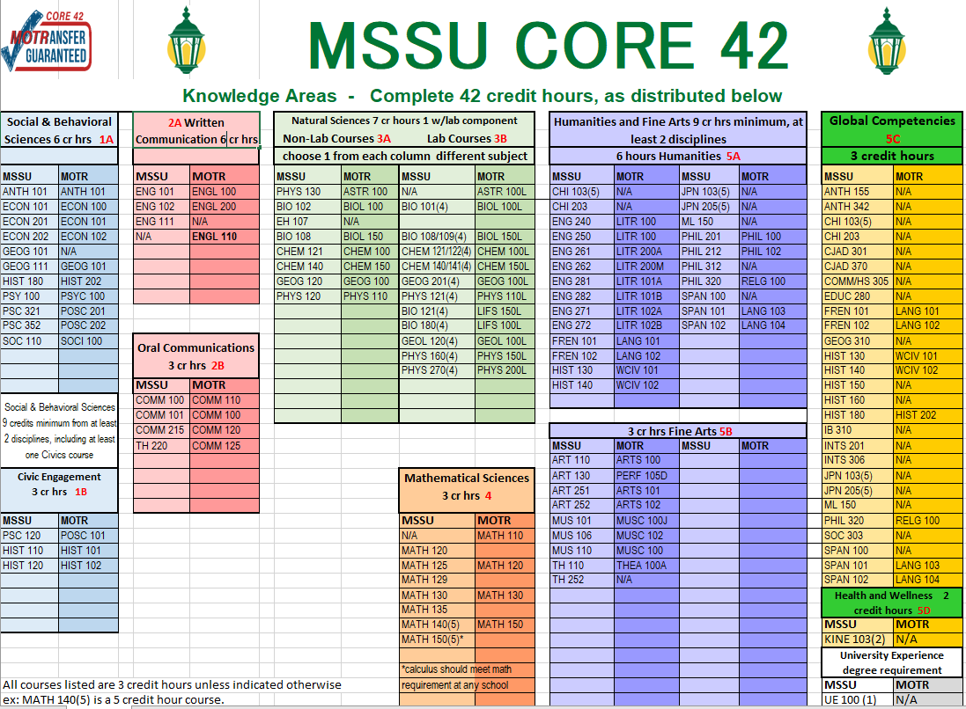

Slide 21
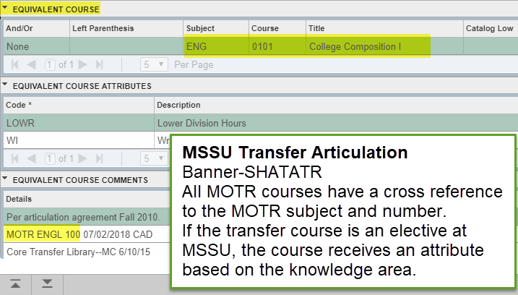

Slide 22
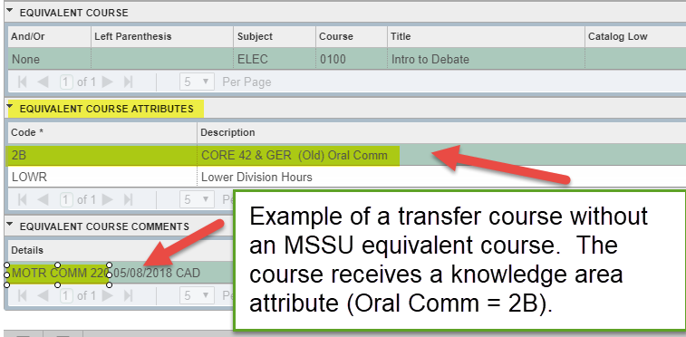
MSSU: Transfer Non-Equivalent

Slide 23
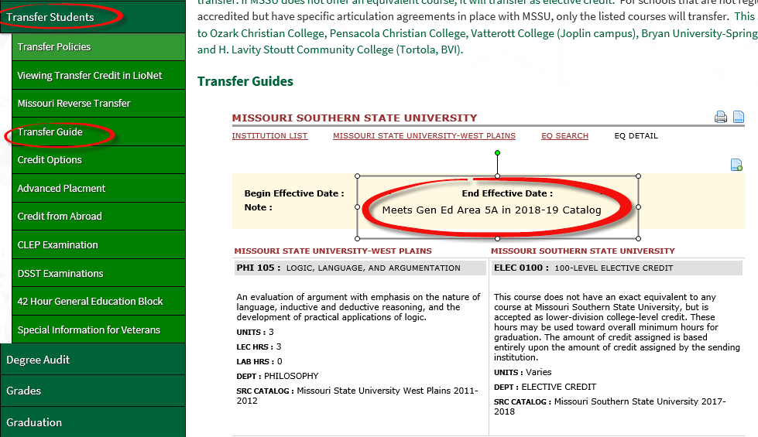
MSSU: Transfer Elective Example

Slide 24
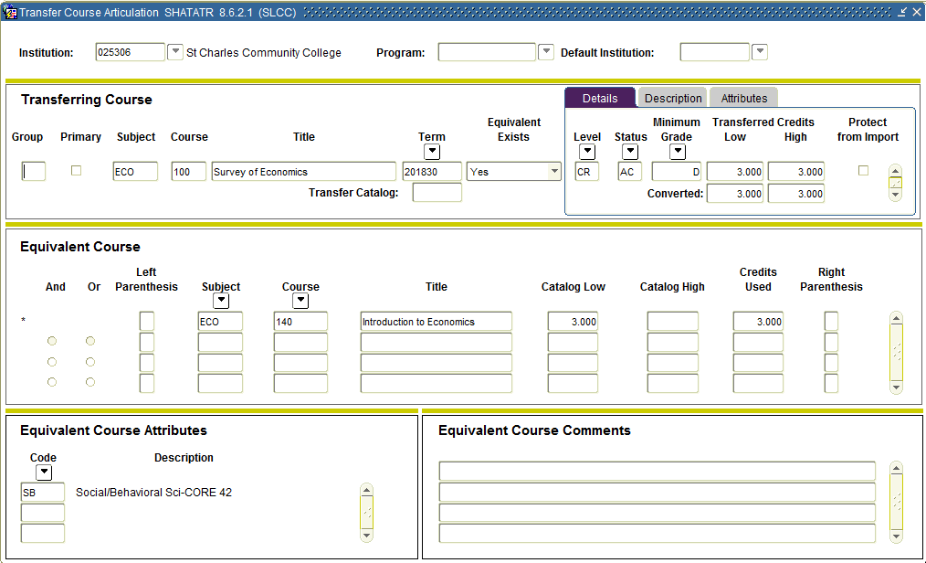
STLCC: Transfer Articulation (Equivalency)

Slide 25
STLCC: Transfer Non-Equivalent
9 new “courses” were created that we refer to as General MOTR courses; each course represents a Knowledge Area:
CORE CIV (CORE 42: Civics)
CORE HFA (CORE 42: Humanities & Fine Arts)
CORE MS (CORE 42: Mathematical Sciences)
CORE ORL (CORE 42: Oral Communication)
CORE PERF (CORE 42: Humanities & Fine Arts-Performance)
CORE SB (CORE 42: Social/Behavioral Sciences)
CORE SL (CORE 42: Science w/ Lab)
CORE SNL (CORE 42: Science No Lab)
CORE WRT (CORE 42: Written Communication)

Slide 26
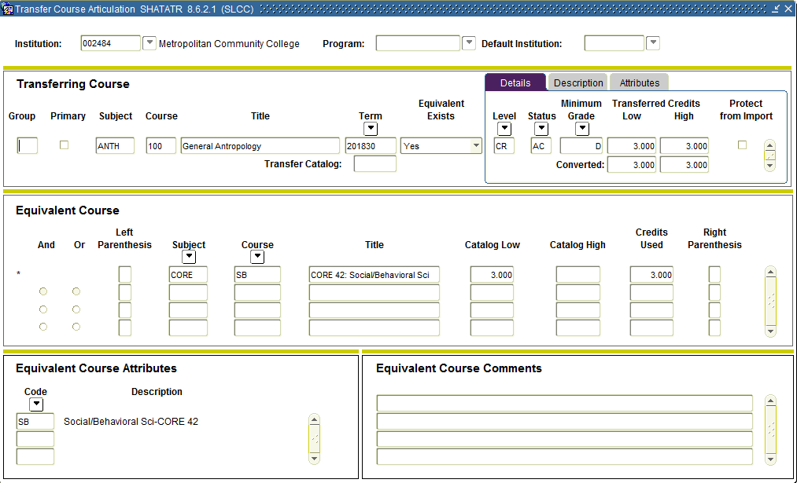
STLCC: Transfer Non-Equivalent

Slide 27
STLCC: Transfer Non-Equivalent
By using General MOTRs, STLCC is making proactive accommodations for non-equivalent courses.
For example, STLCC does not have a course for MOTR ANTH 101. However, several schools, including MSSU have a course that qualifies as MOTR ANTH 101. STLCC will transfer this course in from MSSU as CORE SB. When STLCC computes the CORE 42 “stamp” for the transcript, the logic will consider all MOTRs and General MOTRs.

Slide 28
Transcript & CORE 42 Stamp

Slide 29
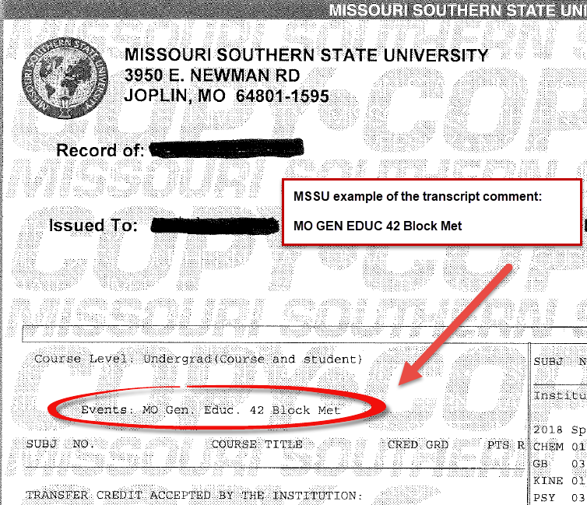

Slide 30
MSSU: CORE 42 Block Banner: STVEVEN and SHATCMT

Slide 31
MSSU - 42 Block Student portal transcript example:
An automated process runs at the first of each month to search for student who have a GENEDBACC block (Degree Works) that is 100% met. This checks against attributes: AA, BS, BA, or CO42. If the student does not have one of these attributes or already have the 42 Event, the comment is added to SHATCMT.
An email is sent notifying the Registrar’s Office the process ran and how many students were included.

Slide 32
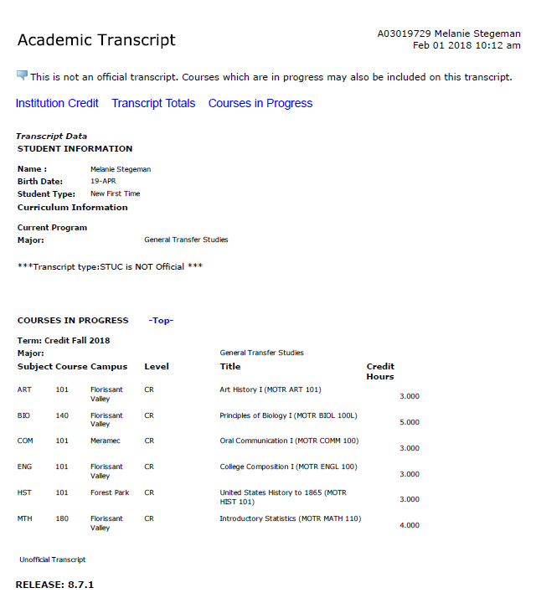
STLCC: Unofficial Transcript
The long course title displays on the unofficial transcript only.

Slide 33
STLCC: Official Transcript
While Banner allows users to select Long Course Title in the Transcript Type Rules form (SHATPRT), it will not print the Long Course Title on the official transcript.
It does display on unofficial transcripts, accessed via Self-Service
Official transcripts display the short course title (excluding the MOTR information).

Slide 34
STLCC: Transcript Stamp
An automated process will run to search for students who have met the CORE 42 criteria. If the student has met the criteria and does not already have the stamp on their transcript, a stamp (event) will be automatically applied via SHATCMT.
This process uses our degree audit system, uAchieve.

Slide 35
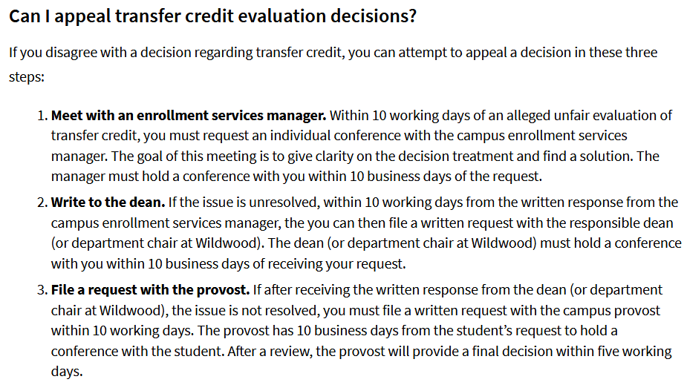
STLCC: Complaint Process
Internal Process for Appeal:
https://www.stlcc.edu/admissions/transfer-planning/transferring-credit-to-stlcc.aspx

Slide 36
MSSU: Complaint Process
Transfer Articulation Appeal Process: Transfer students have the right to appeal course articulation from transferring institutions. If you feel a course has not been given proper credit at MSSU, please contact the Office of the Registrar at MSSU regarding the appeal process. Issues that can be resolved by the Office of the Registrar require no further action by the student or institution.
Courses from non-regionally accredited schools may be challenged for credit by completing a General Academic Petition. The petition must be accompanied with a course syllabus and credentials of the course instructor. Petitions are routed to the department of the course for review and final determination of credit.
Courses from regionally accredited schools that have not been articulated for course credit may be challenged for academic credit toward a degree by completing the General Academic Petition. Appeals require approval from both the department of the course, the department of the major and the respective dean. Disputes regarding how a course was articulated may be challenged through the appeal process also. The academic department has final determination on course articulation.
Transfer students may request the assistance of the articulation officer from the sending institution in reviewing the situation and giving advice on the merits of the appeal. For additional information from the Missouri Department of Higher Education regarding course articulation please visit: IV. Procedures for Review of Credit Transfer Policy and Compliance found at dhe.mo.gov/policies/credit-transfer.php#appeals process.

Slide 37
Things to Remember:
Native is who?
Enrolls and attends one institution with no intent to transfer
May have earned college credit prior to high school graduation or during the summer between high school graduation and preceding fall enrollment
Transfer student is…who?
Any student who has attended another institution after high school
Other than summer terms
Professional programs are what?
Licensure or accreditation constraints require specific gen ed
Exempt from needing CORE 42

Slide 38
CORE 42: (5 areas)

