Slide 1

Credit for Military Learning
Mr. Craig Chandler, ArmyU
https://www.youtube.com/watch?v=zBUTmH5_-c0
10 December 2019
Notes:
Since higher education in America is state centric, ArmyU is partnering with national entities, regional education associations, regional accreditors, and state higher education agencies. The goal is to partner with states to develop general academic or vocational articulation pathways and targeted processes that inform, encourage, and enable service members and veterans to fill critical occupational gaps through credit for military learning processes that work within state systems

Slide 2
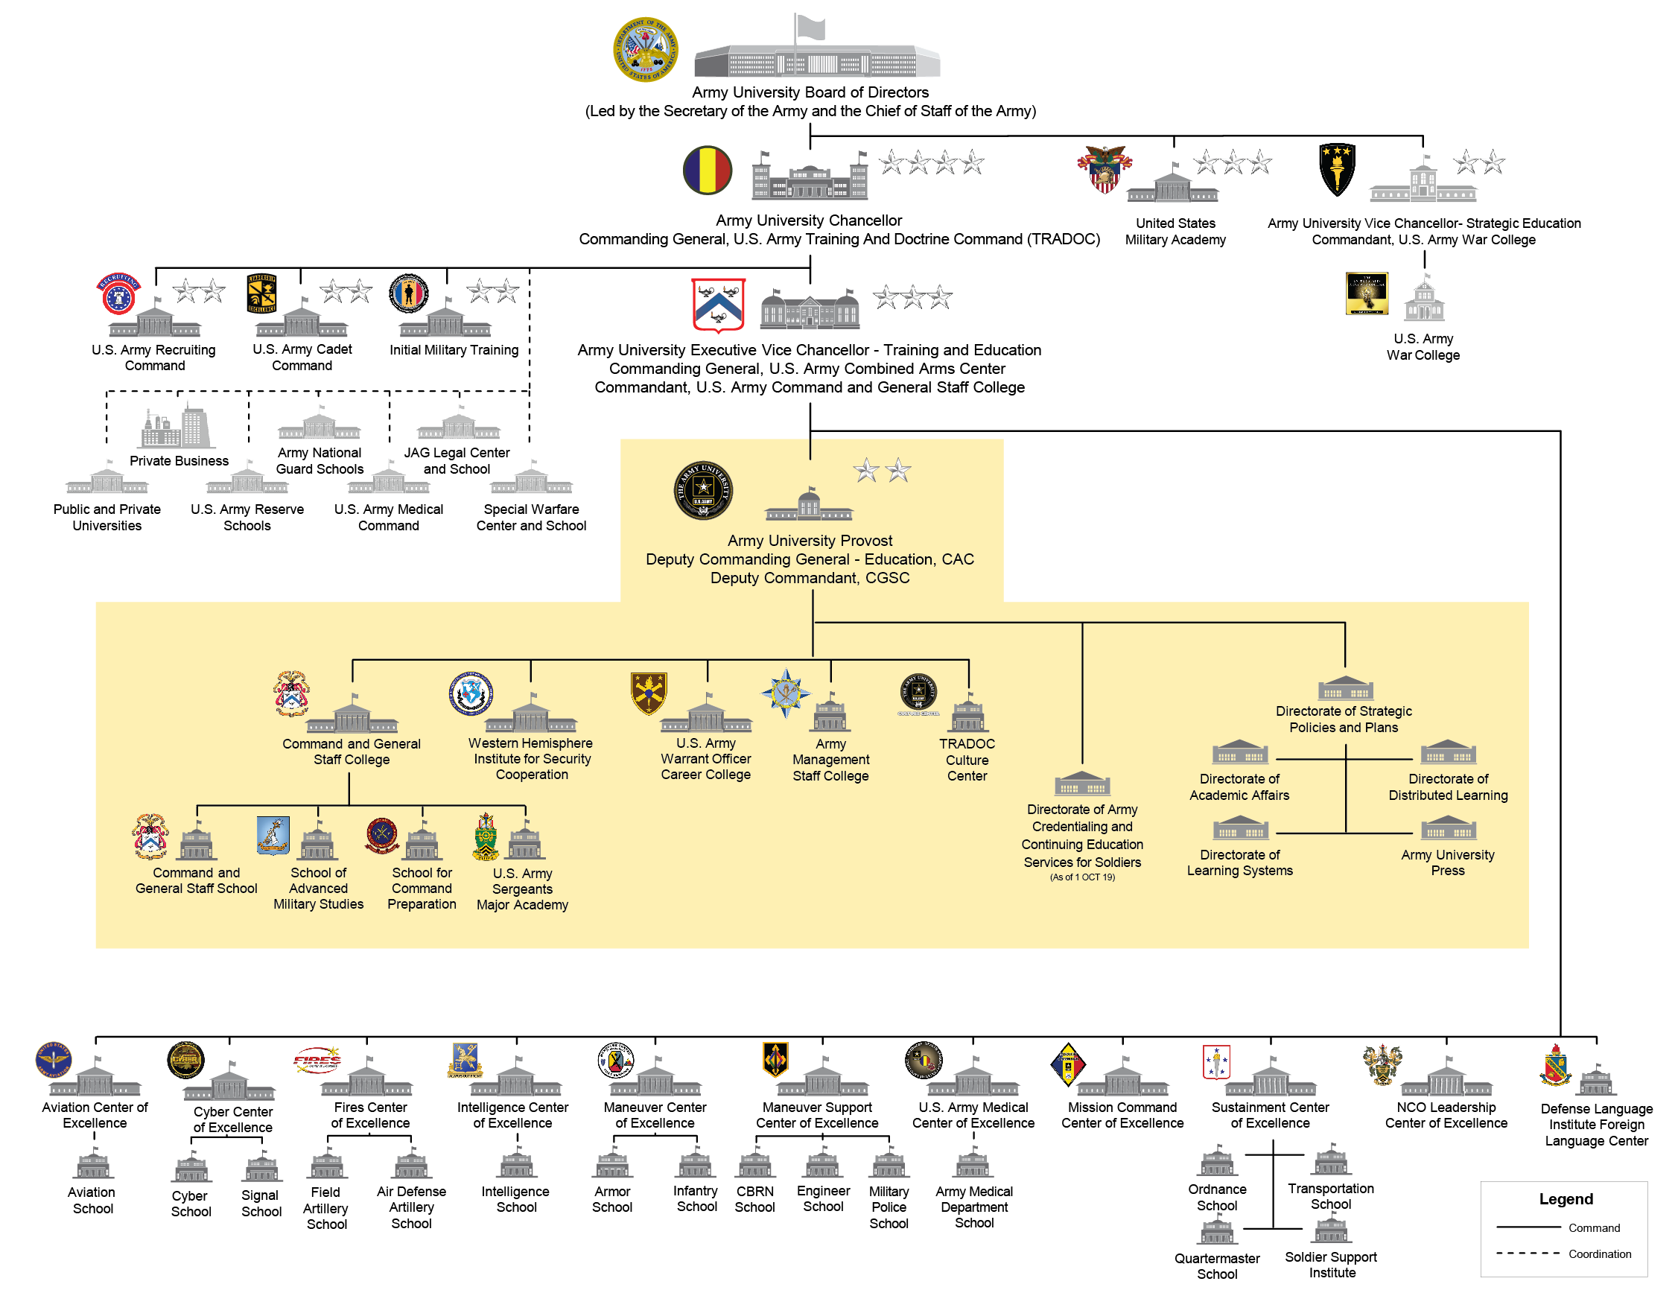
The ArmyU System
ArmyU organizations regional accreditations:
CGSC Accreditations
❶ Higher Learning Commission
(Last: 2016. Next: 2020-2021 Report & Visit)
Master of Military Art and Science
Degree and two Certificate Programs
for CGSOC delivered by CGSS
M.A. in Military Operations for AMSP
and an M.A. in Strategic Studies for
ASLSP delivered by SAMS
B.A. in Leadership & Workforce
Development for resident SMC
at USASMA (2019)
❷ Joint Professional Military Education (JPME) Accreditation
from Joint Staff
❸ TRADOC Accreditation
Most Army Proponent Schools have other accreditations.
Example: the Military Police School is accredited by the Federal Law Enforcement Training Accreditation (FLETA) and the American Correctional Association (ACA)
Regionally accredited by Middle States to offer a master’s degree
❶❷❸
1(a)
1(a)
1(b)
1(c)
❸
LEGEND
Command
Coordination
TRADOC Policy Oversight
Partnership
Army University Affiliation
Regionally accredited by Accrediting Commission for Community & Jr Colleges, WASC

Slide 3
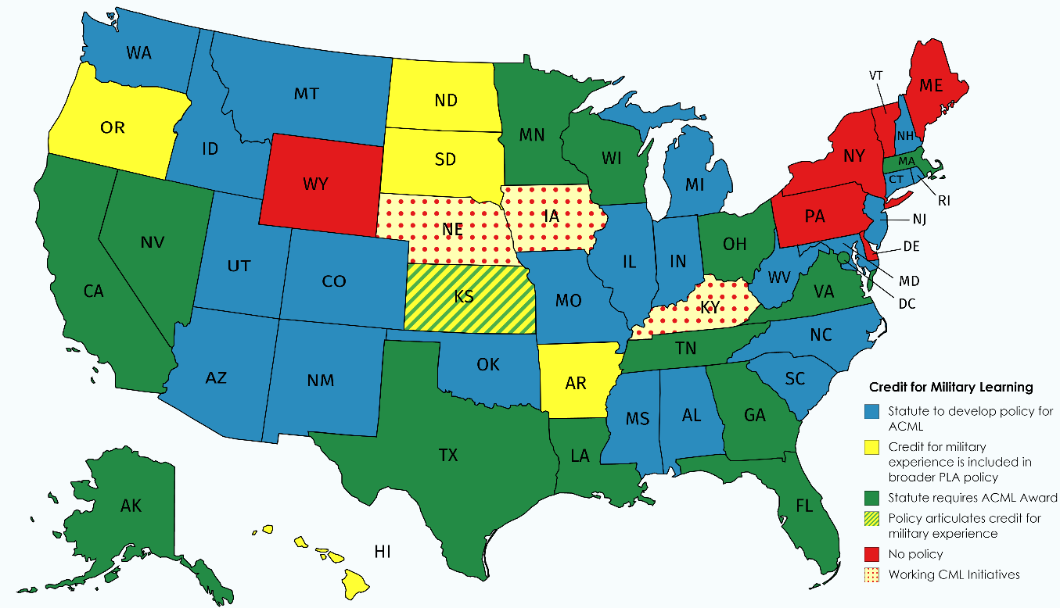
State Statute and Policy Overview: Credit for Military Learning
http://ecs.force.com/mbdata/mbquest3rta?Rep=MIL
ACML-Articulated Credit for Military Learning
PLA-Prior Learning Assessment
https://www.ecs.org/50-state-comparison-prior-learning-assessment-policies/

Slide 4
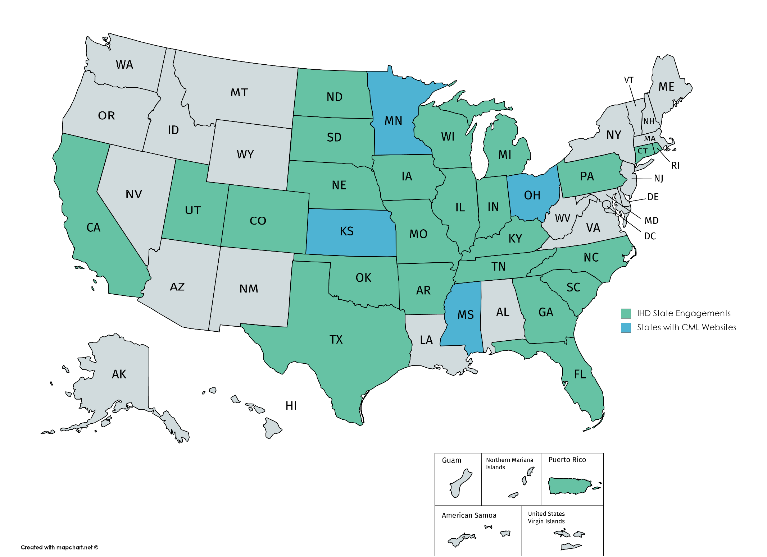
Current ArmyU State Engagements
State Engagements
Active Working Process
Beginning Engagement Process

Slide 5
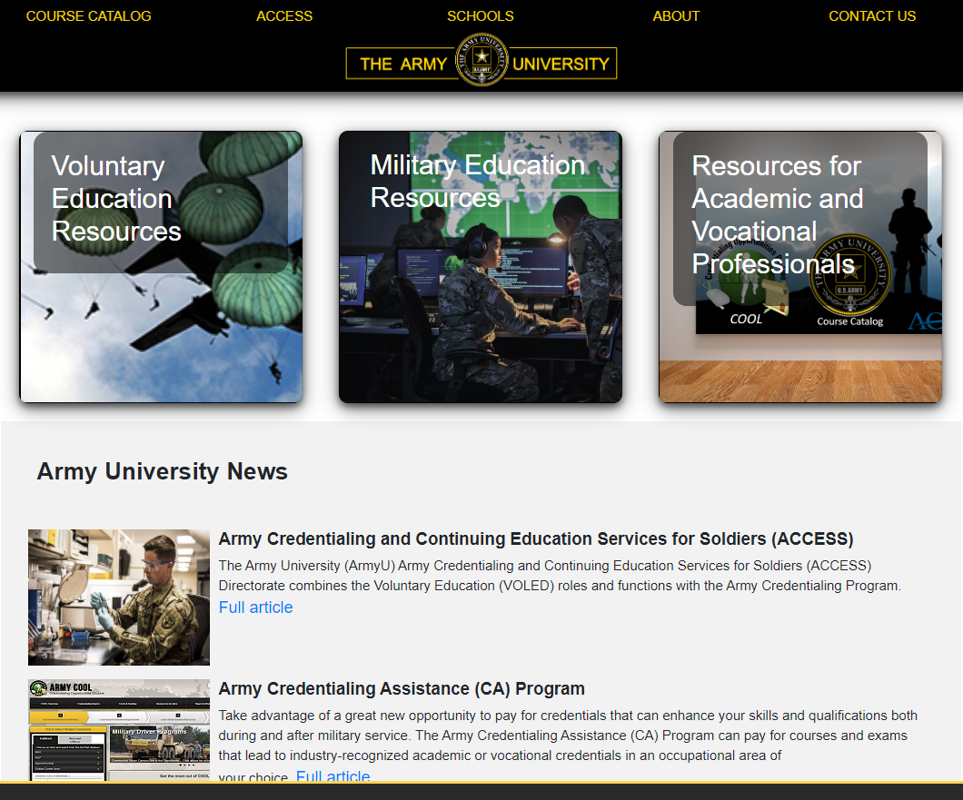
Armyuniversity.edu
Consolidated location for:
ArmyU ACCESS (TA/CA)
JST
DOD VOL ED
USMAPS
ArmyU Course Catalog
ArmyU CMLDb
ArmyU CML resources
ArmyU Library System
ArmyU School Registrars
Army SMS
ArmyU ACE (MIL EVAL)
ArmyU COOL
Other web capabilities
4

Slide 6
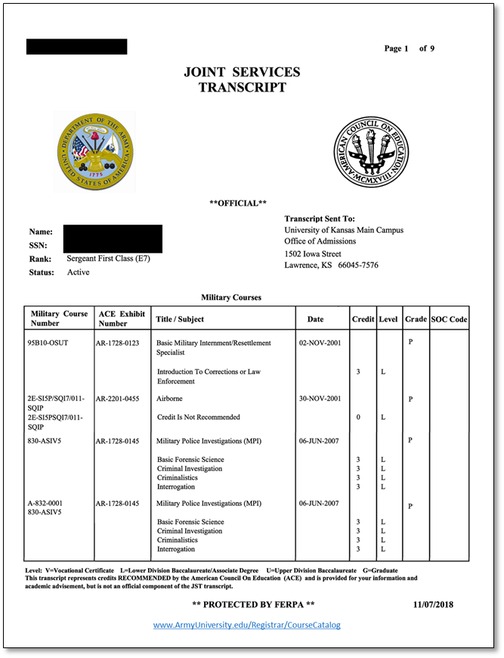
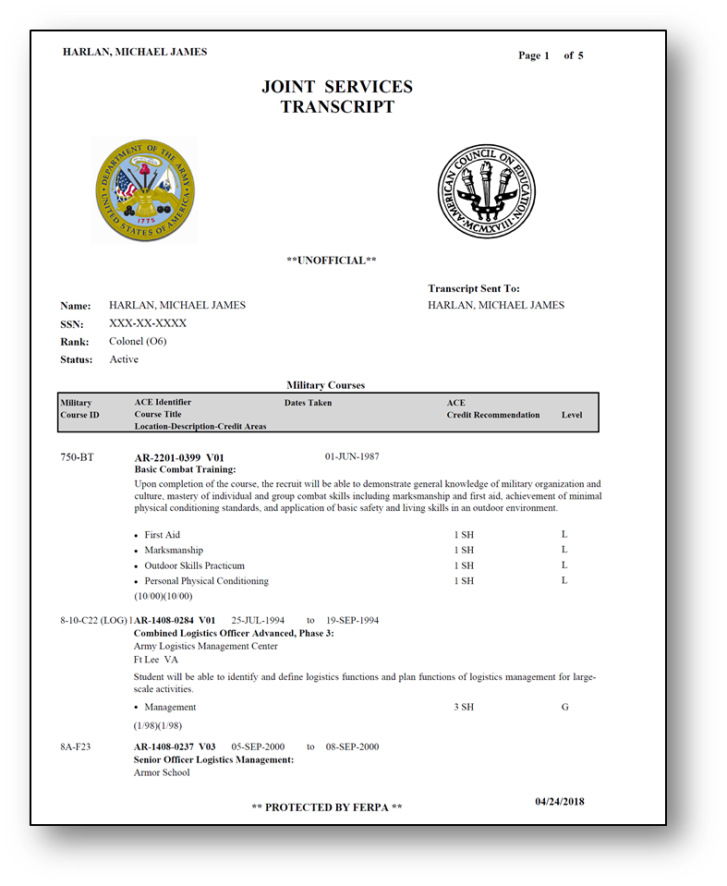
A More “Civilian” Transcript Format
From this
To this
Linked to ArmyU Course Catalog
5
Notes:
Make the JST read more like a traditional transcript and (future) include links in the course entries tied directly to the course catalog, ACE Military Guide, and CMLDb for registrar and student use.

Slide 7


Anticipated Military Advisory Committee and ArmyU Collaboration Benefits
ANTICIPATED MUTUAL BENEFITS
Increased enrollment:
  Current Service Members (Total Tuition Assistance ≈$200 Million/year)
  Veterans (Total Post 911 GI Bill ≈$12 Billion/year)
Increased flow of veterans/service members into targeted state
  Education-to-workforce pathway
  Strengthen/broaden states work force
  State economic benefits
State Higher Education Agencies
OUTCOMES
Credit for Military Learning policy, statute, or agreement development
Identification of military occupation target populations (based on Veteran, Service members)
Processes to review academic and vocational, degrees, certifications, licenses, or credentials and award appropriate credit.
Policy to incorporate review process outcomes into state systems to provide credit transparency and predictability to veterans and service members
Focus on critical occupation
Info
Requests
Department
of Labor
Department
of Commerce
State
National
Guard
Public
Academic
Institutions
Private
Academic
Institutions
State Military Advisory
Committee
Information
6
Notes:
The heart of the credit for military learning process is the military advisory committee. Most states have a military committee, but it is usually focused on veteran issues. We have expanded the scope of these state committees to begin the discussion of creating vocational or academic pathways that enable service members and veterans to fill state identified critical occupations. Army National Guard Education Services Officers are actively seeking ArmyU assistance to support the Credit for Military Learning concept and establishment of Military Advisory Committees. We are recruiting Army National Guard TAGs to champion this initiative and provide state agency collaboration support, to date AR, IA, NE, KS, MS, TX, and KY TAGs or ESOs have responded and are actively working to develop CML processes or MACs within their states with other state agencies.
CML resource page-TFID is developing this capability on the .edu to assist states in developing CML processes and policies that are tailorable to their state. Already we have assisted NE, IA, KY, MS, and GA with policy or process best practices.
CMLDb-we are developing a comprehensive database that links military courses to academic and vocational articulation agreements. Searchable by state, education institution, and linked to the individual military course number, these agreements will greatly assist soldiers by providing transparent and predictable information regarding credit for military learning reflected in their JST.

Slide 8
Credit Review Process Partners
State Agencies
Education Institutions
Education Institutions
State agency partners; Departments of Labor, Commerce, Higher Education, National Guard,
Veterans Administration,
and Workforce Development
State Agencies
Academic or Occupational Education Institutions faculty and staff that grant certifications key to filling identified critical occupations
TRADOC Schools & Centers
Process Partners
State Agencies
Education Institutions
TRADOC Schools
ARNG/USAR
ArmyU
ACE
American Council
on Education
TRADOC Centers & Schools
Military Evaluation Program review determines if the military learning experience has equivalent learning outcomes to a course or credential.
American Council on Education
Nine distinct COEs that manage 32 x schools focused on separate areas of expertise within the Army. These Centers train more than 500,000 Soldiers each year.
A State Faculty Panel Process involves state agencies & education/occupation institution faculty convening to examine course learning outcomes and compare them to the skills, outcomes and competencies learned in various military courses. This process is informed by ACE, ArmyU Course Catalog, ArmyU Credit for Military Learning Database, and military training developer, instructor, and/or SME input.
7

Slide 9
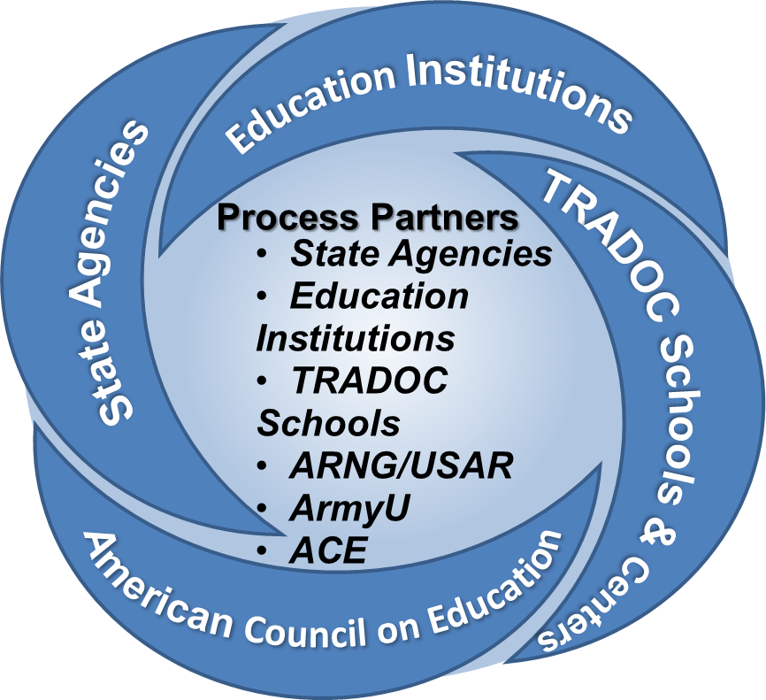
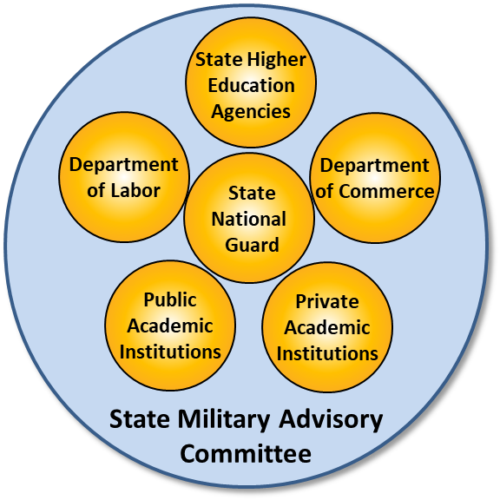

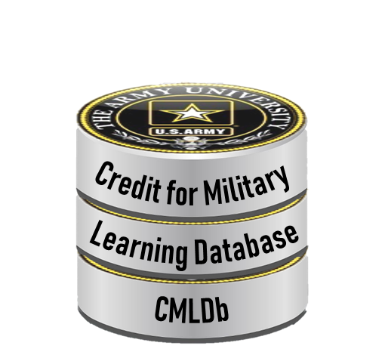
Critical occupation bridging
State statute and policy review
Occupation Outcomes
Critical Occupations license/certification/credential
State Critical Occupations
State Priorities &
Focus
Academic Outcomes
Critical Occupations academic qualifications
Program and course inventories
Military & Veteran Populations
Credential bridging strategy
Informing state systems
ACE Military Guide
Military Course crosswalk
Filling State Critical Occupations
Credit for Military Learning process map
8
Notes:
Credit for Military Learning (CML): ArmyU is partnering with state higher education agencies, regional education associations, and national partners, to create or modify CML processes to create academic or vocational bridging programs matched with state critical occupation shortfalls and incorporate statewide Military Evaluation (American Council on Education) credit recommendations that feed into new or modified state systems. These systems will enable service members and veterans to see their credit for military learning opportunities nationwide and support the Credit for Military Learning Database (CMLDb).

Slide 10
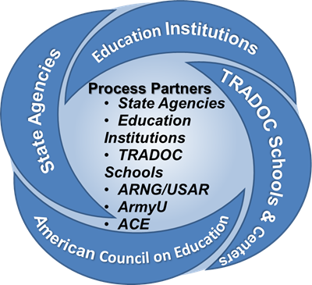
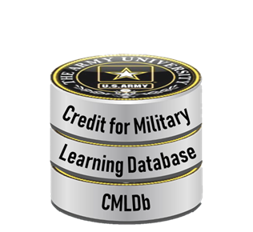
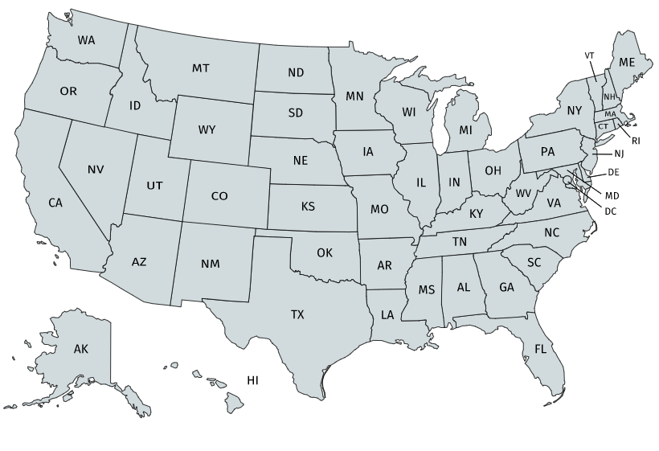

Credit for Military Learning Database
State/Institution Processes & Systems
Priorities
Focus
Data Inputs by Organization
Academic
Outputs
Occupational
State
DoD
DoL
State Course Inventory
State Credential Inventory
State Articulation Agreements
Database of Accredited Postsecondary Institutions & Programs DAPIP-ID
Department of Defense MOU (Yes/No)
Approved Credential Providers
Army COOL
Individual Courses Awarded
State CML Articulation Process outcomes informing state systems
Classification of Instructional Programs code (CIP)
American Council on Education (ACE) Military Guide Course Number
Department of Labor Standard Occupational Classification (DOL-SOC)
CMLDb Webform
Individual Credential Awarded
Military Course Number
Outcomes on the Credit for Military Learning Database
Primary Data Reference Key
9
Notes:
Credit for Military Learning Database (CMLDb): The CMLDb collects all articulation agreement and third party accreditor recommendation credit for military learning system outcomes into a national database, searchable by service members, veterans, and education institutions.

Slide 11
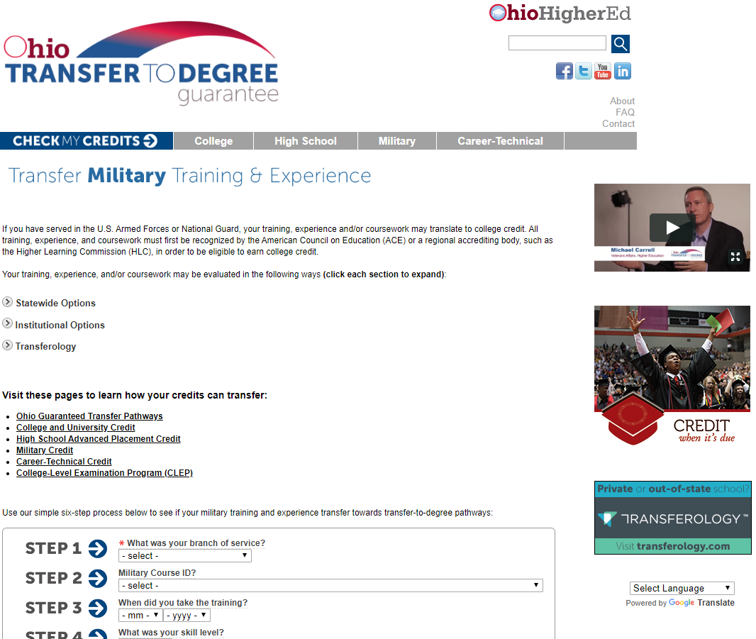
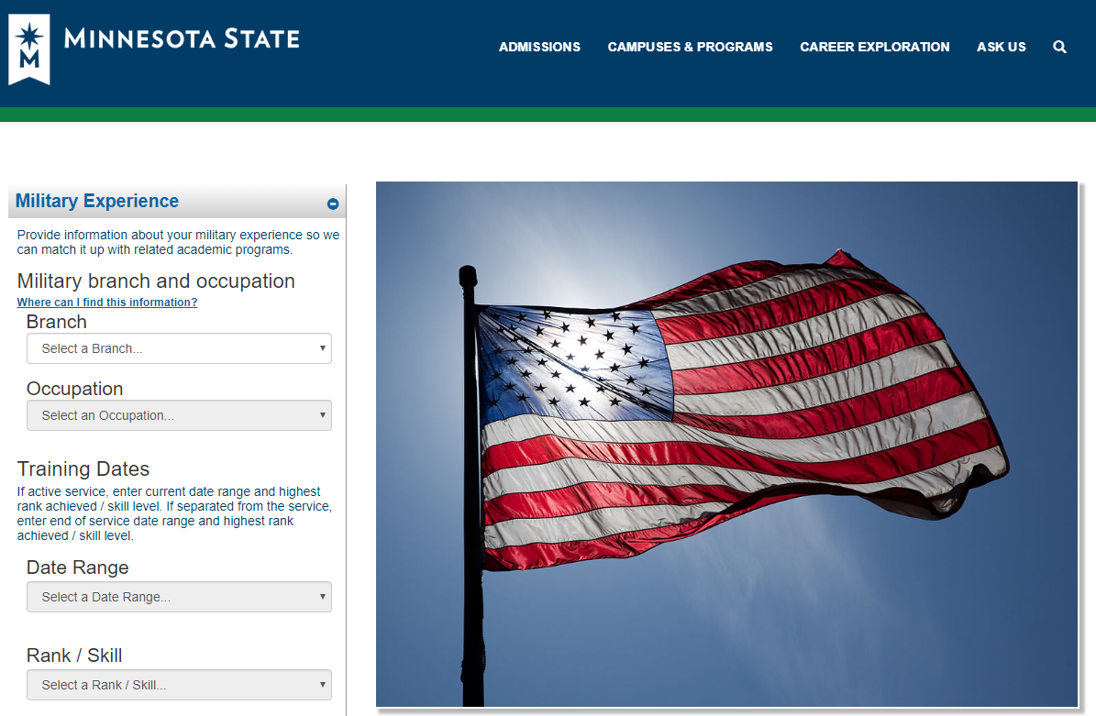
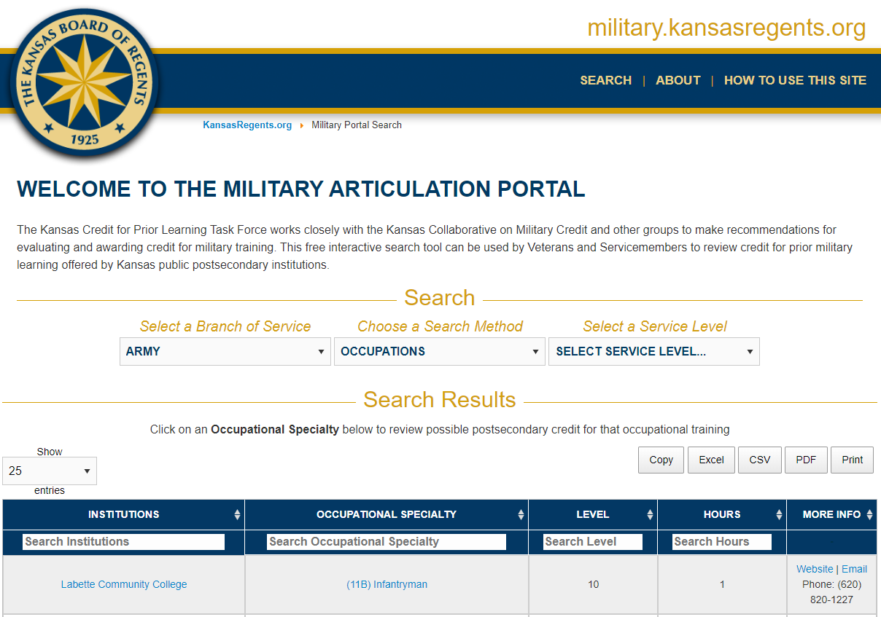
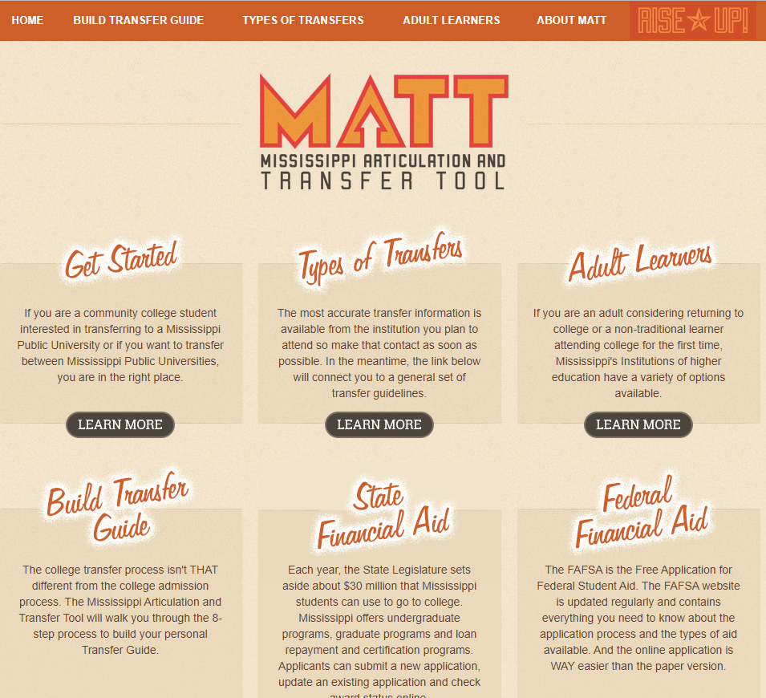
Current state CML process outputs
via web based systems
-Initial CMLDb capability national
map linked to state CML websites. In soldier Vol Ed systems
-Full system will share CML data in
a system for soldier VOL ED
11

Slide 12

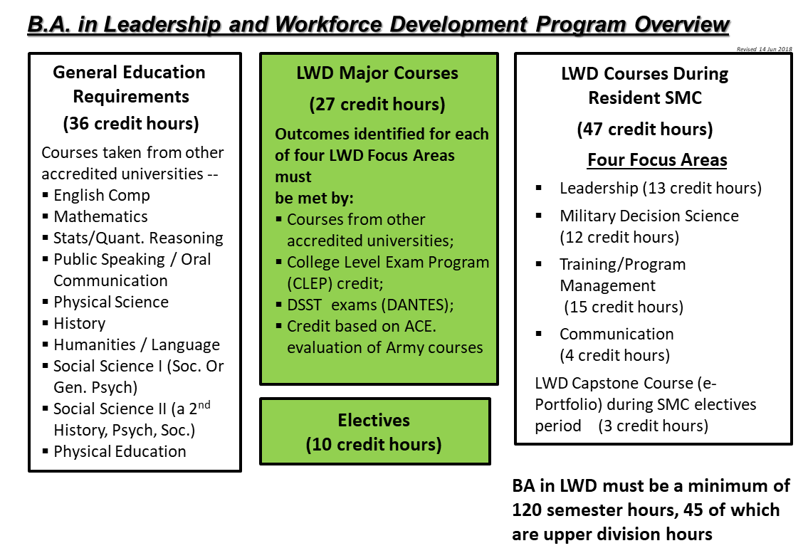
USASMA Degree Completion Program
(B.A. in Leadership & Workforce Development)
12

Slide 13
What Happens When Institutions Can Assess POI Extracts for Themselves…
Recommended by American Council on Education (ACE)
(Individually interpreted credit, some applied as elective):
AR-1723-0026 Allied Trades Specialist (702-91E10/1316-B Phase 1): 9 hours
AR-1723-0020 Allied Trades Specialist (702-91E10 Phase 2): 3 hours
Total of 12 credit hours
Articulated by KBoR Institutions After Program of Instruction (POI) Extract Review
(Articulated Credit, applies to degree completion requirements): 10 Level/30 Level
Barton Community College: 10/25 hours
Butler Community College: 18/39 hours
Garden City Community College: 11/17 hours
Fort Scott Community College: 09/12 hours
Johnson Community College: 18/30 hours
Independence Community College: 16/16 hours
Highland Community College: 17/17 hours
Labette Community College: 13/13 hours
Salina Area Technical College: 25/31 hours
Seward Community College: 17/17 hours
Average hours: 15.4/21.7 (none in electives)
13

Slide 14
Questions?
Points of Contact
Mr. Craig Chandler
Craig.a.chandler4.civ@mail.mil
913.684.7478
MAJ Austin Wilson
Austin.l.wilson.mil@mail.mil
913.684.4123
LTC Jason Lester
Jason.e.lester4.mil@mail.mil
913.684.7482
Mr. Kris Miller
Kristopher.t.miller4.civ@mail.mil
913.684.3572
15

