Slide 1

Proposed HESFA Calculations
Nicole Epstein
General Counsel & Legislative Liaison
Proposed HESFA Calculations
SB 807 & 577 (2018)

Slide 2
For institutions whose tuition is greater than the average tuition, the percentage change in tuition shall not exceed the percentage change of the consumer price index plus a percentage of not more than five percent that would produce an increase in net tuition revenue no greater than the dollar amount by which the state operating support was reduced for the prior fiscal year, if applicable
§173.1003, RSMo
For institutions whose tuition is less than the average tuition, the dollar increase in tuition shall not exceed the product of the percentage change of the consumer price index times the average tuition, plus a percentage of not more than five percent that would produce an increase in net tuition revenue no greater than the dollar amount by which the state operating support was reduced for the prior fiscal year, if applicable
Proposed HESFA Calculations SB 807 & 577 (2018)

Slide 3
Overview of Variables Involved
FY 17 core amount dispersed
FY 18 core amount dispersed
FY 19 Fall 2018 Missouri undergraduate enrollment
FY 19 tuition and fees for Missouri undergraduates
FY 20 consumer price index (CPI)
4 fiscal years
Proposed HESFA Calculations SB 807 & 577 (2018)

Slide 4
Step 1
Determine whether state operating support was reduced for the prior fiscal year
Proposed HESFA Calculations SB 807 & 577 (2018)

Slide 5
Step 1
Determine whether state operating support was reduced for the prior fiscal year
Proposed HESFA Calculations SB 807 & 577 (2018)

Slide 6
Step 1
Determine whether state operating support was reduced for the prior fiscal year
Proposed HESFA Calculations SB 807 & 577 (2018)

Slide 7
What is state operating support?
“the funding actually disbursed from state operating appropriations to approved public institutions and shall not include appropriations of disbursement for special initiatives or specific program additions or expansions”
Statute
Proposed HESFA Calculations SB 807 & 577 (2018)

Slide 8
What is state operating support?
“the funding actually disbursed from state operating appropriations to approved public institutions and shall not include appropriations of disbursement for special initiatives or specific program additions or expansions”
Statute
DHE Interpretation
Institutions won’t know the actual disbursed amount until June 30th when the fiscal year ends, so we’ll look at FY 18
Proposed HESFA Calculations SB 807 & 577 (2018)

Slide 9
What is state operating support?
“the funding actually disbursed from state operating appropriations to approved public institutions and shall not include appropriations of disbursement for special initiatives or specific program additions or expansions”
Statute
DHE Interpretation
Institutions won’t know the actual disbursed amount until June 30th when the fiscal year ends, so we’ll look at FY 18
DHE Interpretation
We will only look at the institution’s dispersed core funding
Proposed HESFA Calculations SB 807 & 577 (2018)

Slide 10
What is state operating support?
“the funding actually disbursed from state operating appropriations to approved public institutions and shall not include appropriations of disbursement for special initiatives or specific program additions or expansions”
Statute
DHE Interpretation
Institutions won’t know the actual disbursed amount until June 30th when the fiscal year ends, so we’ll look at FY 18
DHE Interpretation
We will only look at the institution’s dispersed core funding
State operating support = FY 18 core funding disbursed to an institution
Proposed HESFA Calculations SB 807 & 577 (2018)

Slide 11
How do we determine if a reduction occurred?
Statute
“the dollar amount by which the state operating support was reduced for the prior fiscal year”
Proposed HESFA Calculations SB 807 & 577 (2018)

Slide 12
How do we determine if a reduction occurred?
Statute
“the dollar amount by which the state operating support was reduced for the prior fiscal year”
DHE Interpretation
FY 18 core funding disbursed to an institution
Proposed HESFA Calculations SB 807 & 577 (2018)

Slide 13
How do we determine if a reduction occurred?
Statute
“the dollar amount by which the state operating support was reduced for the prior fiscal year”
DHE Interpretation
FY 18 core funding disbursed to an institution
DHE Interpretation
Compare FY 17 core disbursed to FY 18 core disbursed
Proposed HESFA Calculations SB 807 & 577 (2018)

Slide 14
Step 2
If state operating support is not reduced…
NO CHANGE IN PROCESS
FY 19 tuition and fees + CPI = max FY 20 tuition and fees
Proposed HESFA Calculations SB 807 & 577 (2018)

Slide 15
Step 2
If state operating support is reduced…
NEW PROCESS
FY 19 tuition and fees + CPI + X* = max FY 20 tuition and fees
*X = “a percentage of not more than five percent that would produce an increase in net tuition revenue no greater than the dollar amount by which state operating support was reduced for the prior fiscal year”
Proposed HESFA Calculations SB 807 & 577 (2018)

Slide 16
How do we determine X?
“a percentage of not more than five percent that would produce an increase in net tuition revenue no greater than the dollar amount by which state operating support was reduced for the prior fiscal year”
Statute
Proposed HESFA Calculations SB 807 & 577 (2018)

Slide 17
How do we determine X?
“a percentage of not more than five percent that would produce an increase in net tuition revenue no greater than the dollar amount by which state operating support was reduced for the prior fiscal year”
Statute
DHE Interpretation
Dollar amount = FY 18 core disbursed – FY 17 core disbursed
Proposed HESFA Calculations SB 807 & 577 (2018)

Slide 18
How do we determine X?
“a percentage of not more than five percent that would produce an increase in net tuition revenue no greater than the dollar amount by which state operating support was reduced for the prior fiscal year”
Statute
DHE Interpretation
Dollar amount = FY 18 core disbursed – FY 17 core disbursed
DHE Interpretation
To determine the increase in net tuition revenue that will recoup the reduction in state operating support, we will need to divide the dollar amount by the number of Missouri resident undergraduate students
Proposed HESFA Calculations SB 807 & 577 (2018)

Slide 19
How do we determine X?
“a percentage of not more than five percent that would produce an increase in net tuition revenue no greater than the dollar amount by which state operating support was reduced for the prior fiscal year”
Statute
DHE Interpretation
Dollar amount = FY 18 core disbursed – FY 17 core disbursed
DHE Interpretation
To determine the increase in net tuition revenue that will recoup the reduction in state operating support, we will need to divide the dollar amount by the number of Missouri resident undergraduate students
DHE Interpretation
Two options: FY 20 estimated enrollment or FY 19 Fall 2018 actual enrollment
Proposed HESFA Calculations SB 807 & 577 (2018)

Slide 20
How do we determine X?
“a percentage of not more than five percent that would produce an increase in net tuition revenue no greater than the dollar amount by which state operating support was reduced for the prior fiscal year”
Statute
DHE Interpretation
Dollar amount = FY 18 core disbursed – FY 17 core disbursed
DHE Interpretation
To determine the increase in net tuition revenue that will recoup the reduction in state operating support, we will need to divide the dollar amount by the number of Missouri resident undergraduate students
DHE Interpretation
Two options: FY 20 estimated enrollment or FY 19 Fall 2018 actual enrollment
DHE Interpretation
FY 19 Fall 2018 actual enrollment would be the most accurate number given that institutions would need their estimated enrollment by January 2019 for FY 20
Proposed HESFA Calculations SB 807 & 577 (2018)

Slide 21
How do we determine X?
“a percentage of not more than five percent that would produce an increase in net tuition revenue no greater than the dollar amount by which state operating support was reduced for the prior fiscal year”
Statute
DHE Interpretation
Dollar amount = FY 18 core disbursed – FY 17 core disbursed
DHE Interpretation
To determine the increase in net tuition revenue that will recoup the reduction in state operating support, we will need to divide the dollar amount by the number of Missouri resident undergraduate students
DHE Interpretation
Since it relates to
net tuition revenue, we cannot simply divide the reduced dollar amount by the number of students to find X
Two options: FY 20 estimated enrollment or FY 19 Fall 2018 actual enrollment
DHE Interpretation
FY 19 Fall 2018 actual enrollment would be the most accurate number given that institutions would need their estimated enrollment by January 2019 for FY 20
Proposed HESFA Calculations SB 807 & 577 (2018)

Slide 22
How do we determine net tuition revenue?
Statute
“net amount of resident undergraduate tuition and required fees reduced by institutional aid only”
Proposed HESFA Calculations SB 807 & 577 (2018)

Slide 23
How do we determine net tuition revenue?
Statute
“net amount of resident undergraduate tuition and required fees reduced by institutional aid only”
Statute
“Includes all aid awarded to the student by the student’s institution of higher education only from such institution's funds…does not include the following: Pell Grants; state awards such as the Missouri higher education academic scholarship program, the A+ schools program, and the access Missouri financial aid program; foundation scholarships; third-party scholarships; employee and dependent fee waivers; and student loans”
Proposed HESFA Calculations SB 807 & 577 (2018)

Slide 24
How do we determine net tuition revenue?
Statute
“net amount of resident undergraduate tuition and required fees reduced by institutional aid only”
Statute
“Includes all aid awarded to the student by the student’s institution of higher education only from such institution's funds…does not include the following: Pell Grants; state awards such as the Missouri higher education academic scholarship program, the A+ schools program, and the access Missouri financial aid program; foundation scholarships; third-party scholarships; employee and dependent fee waivers; and student loans”
*Note: this definition of “net tuition revenue” is the same definition that is used in performance funding
Proposed HESFA Calculations SB 807 & 577 (2018)

Slide 25
How do we determine net tuition revenue?
Statute
“net amount of resident undergraduate tuition and required fees reduced by institutional aid only”
Statute
“Includes all aid awarded to the student by the student’s institution of higher education only from such institution's funds…does not include the following: Pell Grants; state awards such as the Missouri higher education academic scholarship program, the A+ schools program, and the access Missouri financial aid program; foundation scholarships; third-party scholarships; employee and dependent fee waivers; and student loans”
DHE Interpretation
Collect the discount rate for each institution and add that rate to the overall per student increase
Proposed HESFA Calculations SB 807 & 577 (2018)

Slide 26
How do we determine net tuition revenue?
Statute
“net amount of resident undergraduate tuition and required fees reduced by institutional aid only”
Statute
“Includes all aid awarded to the student by the student’s institution of higher education only from such institution's funds…does not include the following: Pell Grants; state awards such as the Missouri higher education academic scholarship program, the A+ schools program, and the access Missouri financial aid program; foundation scholarships; third-party scholarships; employee and dependent fee waivers; and student loans”
DHE Interpretation
Collect the discount rate for each institution and add that rate to the overall per student increase
DHE Interpretation
This number yields the total allowable per student increase to recoup the amount reduced in state operating support
Proposed HESFA Calculations SB 807 & 577 (2018)

Slide 27
How do we determine net tuition revenue?
Statute
“net amount of resident undergraduate tuition and required fees reduced by institutional aid only”
Statute
“Includes all aid awarded to the student by the student’s institution of higher education only from such institution's funds…does not include the following: Pell Grants; state awards such as the Missouri higher education academic scholarship program, the A+ schools program, and the access Missouri financial aid program; foundation scholarships; third-party scholarships; employee and dependent fee waivers; and student loans”
DHE Interpretation
Collect the discount rate for each institution and add that rate to the overall per student increase
Remember: X = a percentage that recoups the amount that state operating support was reduced
DHE Interpretation
This number yields the total allowable per student increase to recoup the amount reduced in state operating support
Proposed HESFA Calculations SB 807 & 577 (2018)

Slide 28
How do we determine X?
“consumer price index plus a percentage of not more than five percent that would produce an increase in net tuition revenue no greater than the dollar amount by which state operating support was reduced for the prior fiscal year”
Statute
Proposed HESFA Calculations SB 807 & 577 (2018)

Slide 29
How do we determine X?
“consumer price index plus a percentage of not more than five percent that would produce an increase in net tuition revenue no greater than the dollar amount by which state operating support was reduced for the prior fiscal year”
Statute
DHE Interpretation
Since it states “plus a percentage,” we will add the total allowable per student increase to recoup the amount reduced in state operating support to the FY 19 + CPI amount
Proposed HESFA Calculations SB 807 & 577 (2018)

Slide 30
How do we determine X?
“consumer price index plus a percentage of not more than five percent that would produce an increase in net tuition revenue no greater than the dollar amount by which state operating support was reduced for the prior fiscal year”
Statute
DHE Interpretation
Since it states “plus a percentage,” we will add the total allowable per student increase to recoup the amount reduced in state operating support to the FY 19 + CPI amount
DHE Interpretation
This yields the maximum allowed tuition and required fees for FY 20
Proposed HESFA Calculations SB 807 & 577 (2018)

Slide 31
How do we determine X?
“consumer price index plus a percentage of not more than five percent that would produce an increase in net tuition revenue no greater than the dollar amount by which state operating support was reduced for the prior fiscal year”
Statute
DHE Interpretation
Since it states “plus a percentage,” we will add the total allowable per student increase to recoup the amount reduced in state operating support to the FY 19 + CPI amount
DHE Interpretation
This yields the maximum allowed tuition and required fees for FY 20
DHE Interpretation
We will convert that number into a percentage increase above FY 19 + CPI
*The increase above FY 19 + CPI cannot exceed the statutory cap of 5%
Proposed HESFA Calculations SB 807 & 577 (2018)

Slide 32
EXCEL
DEMONSTRATION
Proposed HESFA Calculations SB 807 & 577 (2018)

Slide 33
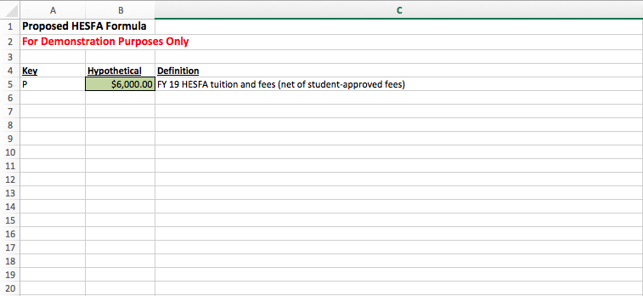
Proposed HESFA Calculations SB 807 & 577 (2018)

Slide 34
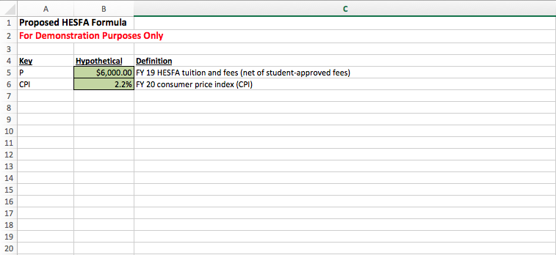
Proposed HESFA Calculations SB 807 & 577 (2018)

Slide 35
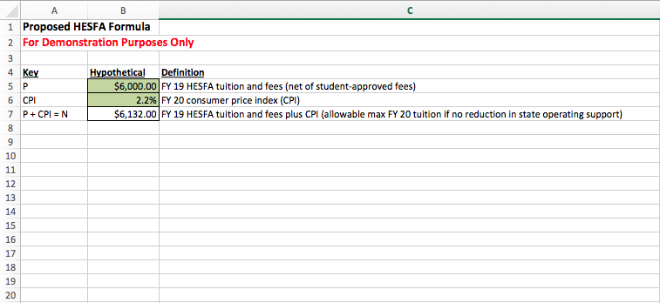
Proposed HESFA Calculations SB 807 & 577 (2018)

Slide 36

IF NO REDUCTION IN STATE OPERATING SUPPORT
Proposed HESFA Calculations SB 807 & 577 (2018)

Slide 37
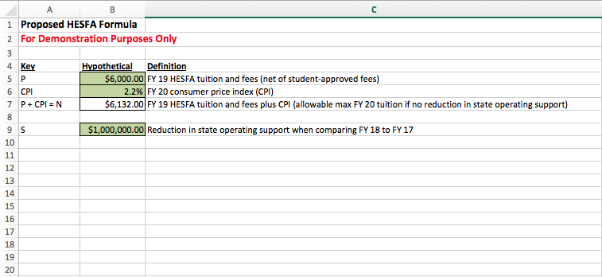
Proposed HESFA Calculations SB 807 & 577 (2018)

Slide 38
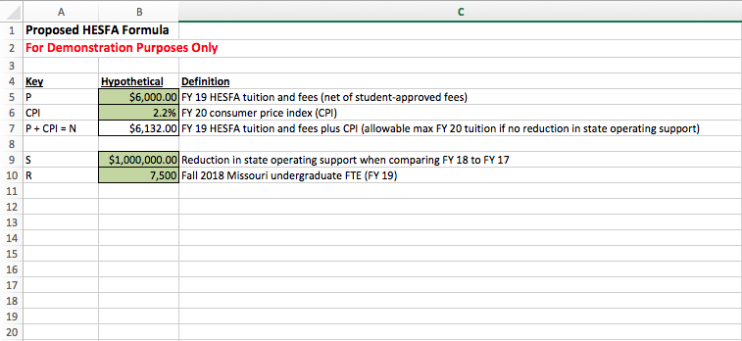
Proposed HESFA Calculations SB 807 & 577 (2018)

Slide 39
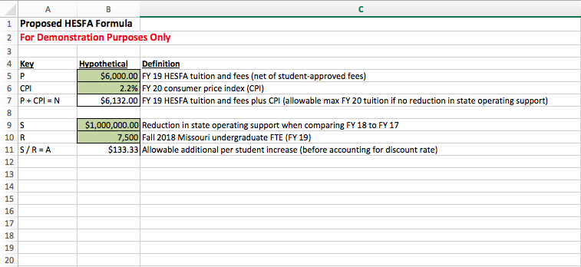
Proposed HESFA Calculations SB 807 & 577 (2018)

Slide 40
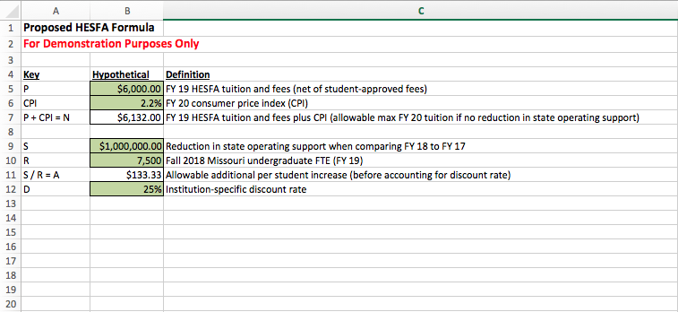
Proposed HESFA Calculations SB 807 & 577 (2018)

Slide 41
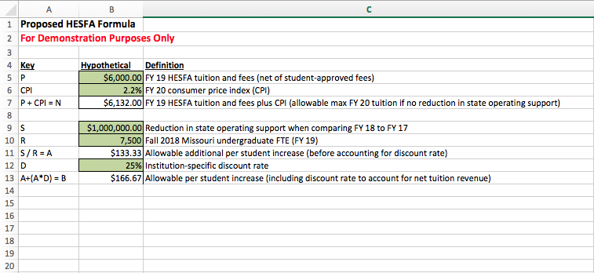
Proposed HESFA Calculations SB 807 & 577 (2018)

Slide 42

Proposed HESFA Calculations SB 807 & 577 (2018)

Slide 43
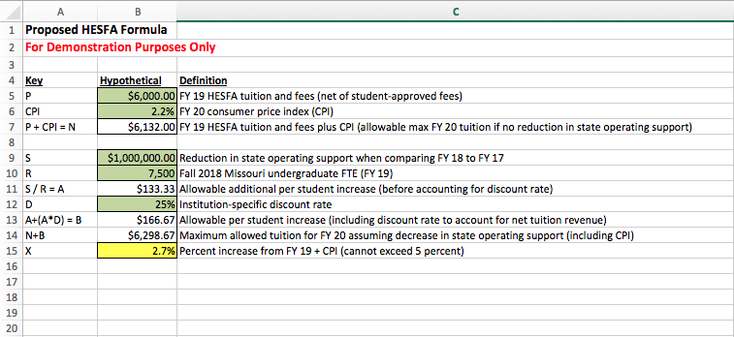
Proposed HESFA Calculations SB 807 & 577 (2018)

Slide 44
Thoughts? Questions?
Feedback is welcome!
Contact Information
Nicole Epstein
General Counsel & Legislative Liaison
nicole.epstein@dhe.mo.gov
(573) 526-1577
Proposed HESFA Calculations SB 807 & 577 (2018)

