Slide 1
Transfer Student Orientation
Jeremy Brinning and Erin Shaw
Truman State University
January 2013 – COTA Conference

Slide 2
Agenda
Introductions and Audience
Brief History of Transfer Student Orientation at Truman
Past Orientation Content
Feedback Loop
Improvements for Fall 2012/Spring 2013
Lessons Learned
Sharing Across Institutions
Notes:
Welcome and Agenda (Erin)
We’re not experts
We can all learn from each other
This is how we do things, what about you?

Slide 3
Introductions and Audience
Jeremy Brinning
Admissions Counselor for Transfer Programs
Erin Shaw
Primary Transfer Academic Advisor
Who is in the room?
Notes:
Admissions Perspective on Orientation - Admissions/Recruitment Tool (Jeremy)
Advising Perspective on Orientation (Advising/Retention Tool)
Who is in the room? (Jeremy)

Slide 4
Transfer Student Orientation at Truman
Focus group formed with students, faculty and staff
Began as a separate orientation around 2006
How many?
When does it occur?
Where does it take place?
How long does it last?
What activities/information have we included in the past?
Notes:
Brief History (Jeremy)
How many years?
Transfers noted as a necessary demographic around 2005
Focus group formed with students, faculty and staff
Created recommendations for future growth
Two separate Orientations annually
Fall
4 days
Spring –1 ½ days
Bring between 200-270 transfers annually each year
Charge fee for orientation expenses ($50)
What we have done in the past (Erin)

Slide 5
Feedback and Changes
How have we gathered feedback?
What have we changed based on student/faculty/staff feedback?
Student Map example
Notes:
How have we gathered feedback? What have we learned? (Jeremy)
Pre-Orientation Surveys
Post Orientation Surveys
Student Senate-lead Transfer student Forum
Peer Mentoring (Transfer Adjustment) Program
Liaisons in program
What have we changed based on student/faculty/staff feedback? (Erin)
For fall
Included more Truman Week activities for transfers to participate in activities with freshmen, if desired
Removed our activities that conflicted with TW activities (ex: Sunday night)
Added formal welcome on Sunday
Added breakfasts back to schedule but included structured mingling
Added scavenger hunt to find campus resources and dept. offices and library tour for bigger prizes
(in concert w/ university focus on mission) Added Truman Transfer Experience panel
(feedback from fall) Added more opportunities to interact with students who previously transferred
Shortened fall orientation so students had full day before classes to run errands
Moved final group dinner to night before classes to wrap up before classes started/improve attendance
Removed info session topics that are covered during Truman Week
For spring (TAL feedback) Moved activities earlier in the day so ended earlier
(eval feedback) Moved campus tour before mini majors day and allowed time to look for classes
(in concert w/ university focus on mission) Added Truman Transfer Experience panel
Panel talked during dinner instead of playing games
Added “Did all of your credits transfer?” talk to Sunday night dinner
Reordered rotating presentations and offered prizes to keep them there
Added Student Health Center/University Counseling Services to presentations
Student Map example (Jeremy)

Slide 7
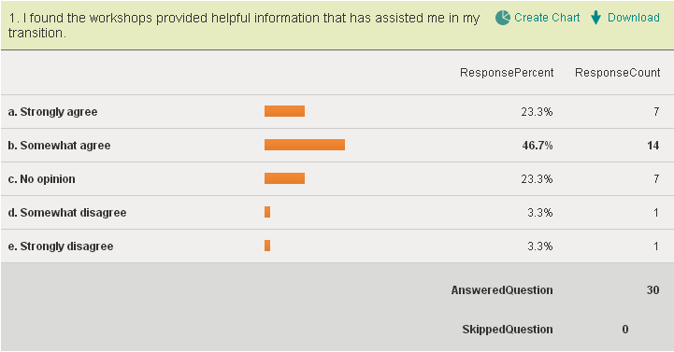
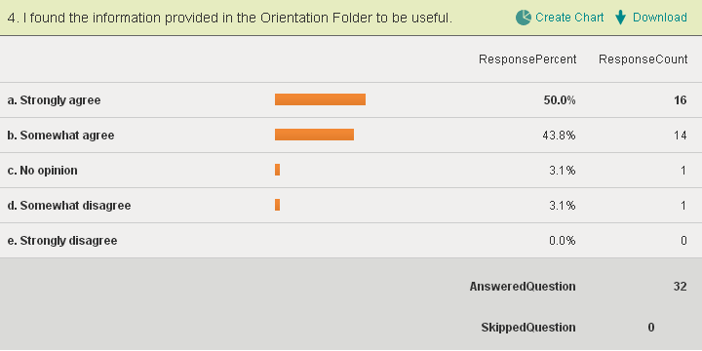
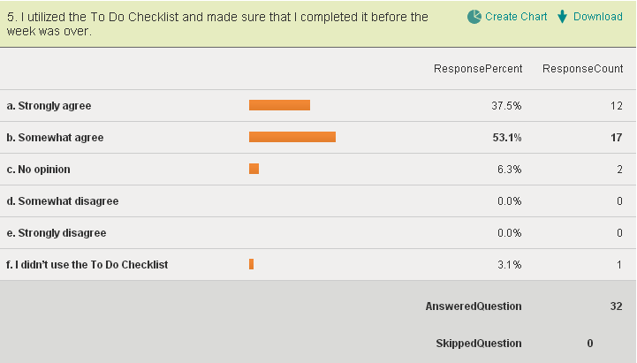
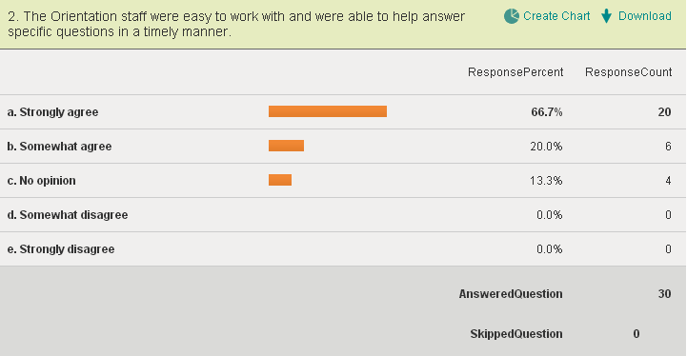
Spring 2011 Responses
Fall 2012 Responses
Notes:
Although different questions we know these are things we should keep or modify the least.

Slide 8
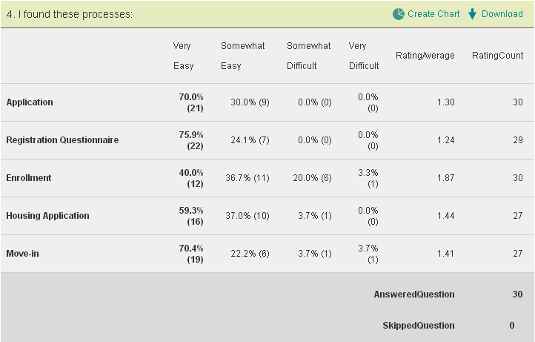
Areas of Improvement

Slide 9
Feedback and Changes
How have we gathered feedback?
What have we changed based on student/faculty/staff feedback?
Student Map example
Notes:
How have we gathered feedback? What have we learned? (Jeremy)
Pre-Orientation Surveys
Post Orientation Surveys
Student Senate-lead Transfer student Forum
Peer Mentoring (Transfer Adjustment) Program
Liaisons in program
What have we changed based on student/faculty/staff feedback? (Erin)
For fall
Included more Truman Week activities for transfers to participate in activities with freshmen, if desired
Removed our activities that conflicted with TW activities (ex: Sunday night)
Added formal welcome on Sunday
Added breakfasts back to schedule but included structured mingling
Added scavenger hunt to find campus resources and dept. offices and library tour for bigger prizes
(in concert w/ university focus on mission) Added Truman Transfer Experience panel
(feedback from fall) Added more opportunities to interact with students who previously transferred
Shortened fall orientation so students had full day before classes to run errands
Moved final group dinner to night before classes to wrap up before classes started/improve attendance
Removed info session topics that are covered during Truman Week
For spring (TAL feedback) Moved activities earlier in the day so ended earlier
(eval feedback) Moved campus tour before mini majors day and allowed time to look for classes
(in concert w/ university focus on mission) Added Truman Transfer Experience panel
Panel talked during dinner instead of playing games
Added “Did all of your credits transfer?” talk to Sunday night dinner
Reordered rotating presentations and offered prizes to keep them there
Added Student Health Center/University Counseling Services to presentations
Student Map example (Jeremy)

Slide 10
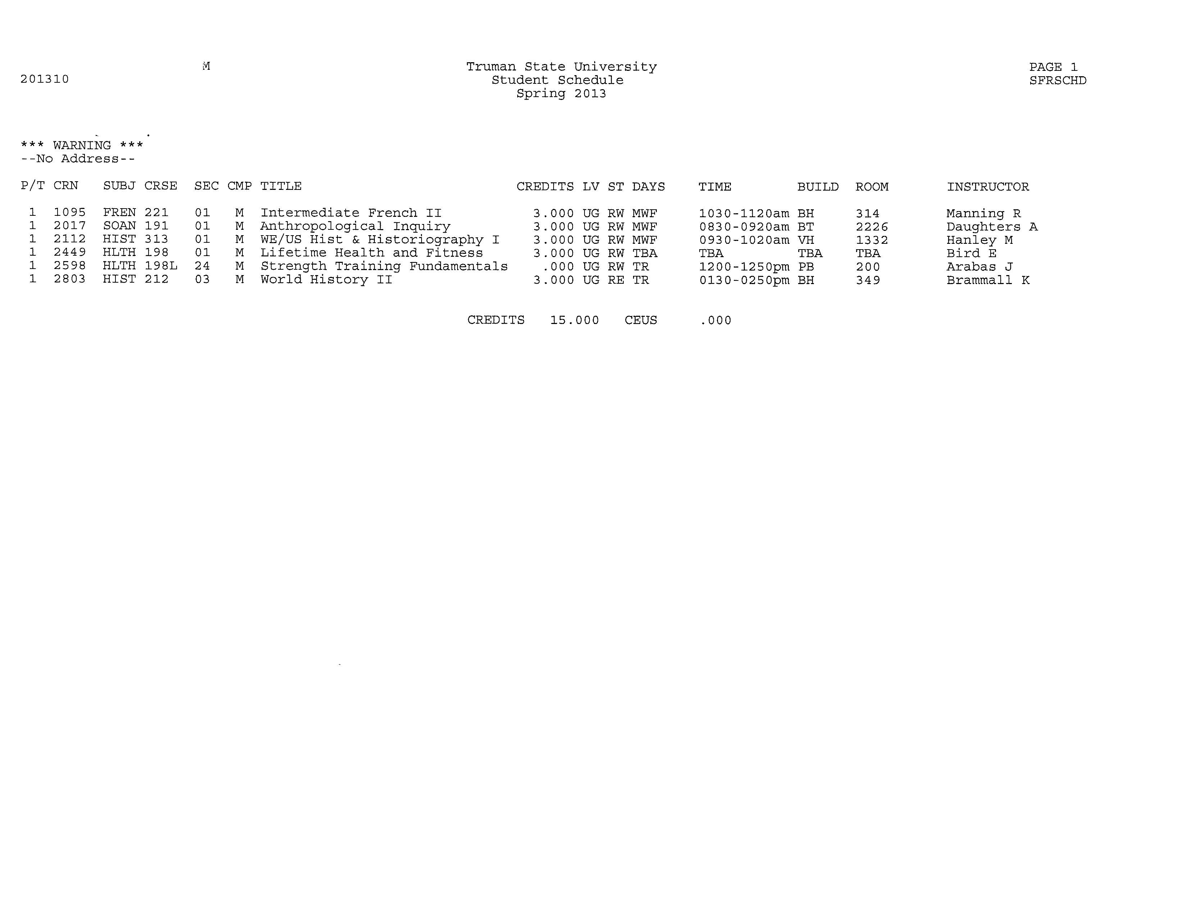
Notes:
Current Student Schedule
Note the Building and Rooms
Knows classes
Where is the student’s class?

Slide 11
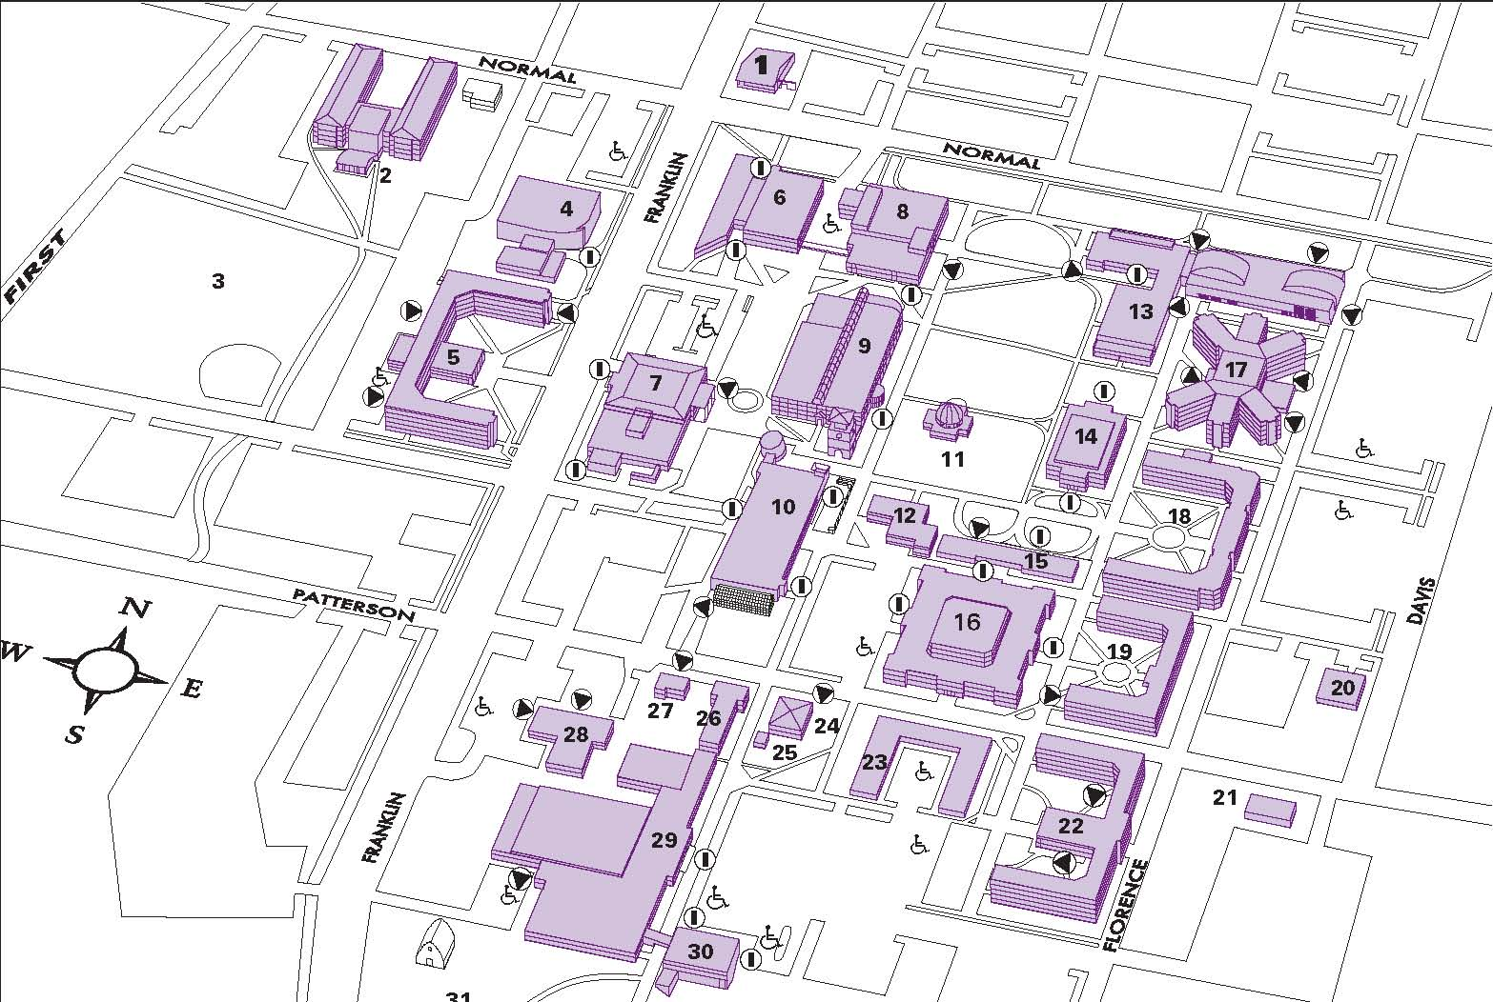

Slide 12
Notes:
Now look at how the schedule is set up.
Easier to find?

Slide 13
Lessons Learned/Future Plans
Increased enrollments translate to new activities
Spring 2010 versus Spring 2013
Fall 2010 versus Fall 2012
Still end up competing with Walmart ☹
Current students need to be on-campus
Keep improving inclusivity of underrepresented populations
Notes:
Lessons Learned/Future Plans (Erin)
Increased enrollments translate to new activities
Spring 2010 versus Spring 2013 – ate at restaurant together versus 35/56 stayed on for Sunday dinner
Fall 2010 versus Fall 2012 – picked up their stuff and left versus stayed for welcome and afternoon sessions
Still end up competing with Walmart
Fall – dismal attendance at the Administrator Luncheon where students can eat with dept chairs and President
Current students need to be on-campus
Adding panels has been positively received but they need to shift to when students are on campus
Keep improving inclusivity of underrepresented populations
International transfer students
Long-distance commuters
Student-Parents
GLBTQ Luncheon
Multicultural Affairs Orientation Dinner

Slide 14
How about you?
4-year institutions
Do you offer a transfer student orientation?
Size of your transfer cohorts?
What have you learned?
Similarities/Differences?
2-year institutions
What anxieties do your students share with you about transferring to a university?
What else should we help incoming transfer orient to?
Do you offer a transfer student orientation?
Notes:
How about you? (Jeremy)

Slide 15
Questions? Transfer@truman.edu
Jeremy Brinning
Admissions Counselor for Transfer Programs
jbrinning@truman.edu
Erin Shaw
Academic Advisor
eshaw@truman.edu

